Slide 1
End to End AI development with Azure AI Foundry
Wai Man Hui - Microsoft Cloud Solution Architect
Kinfey Lo - Microsoft Senior Cloud Advocate

Slide 2
Agenda
What's new in Microsoft AI
Unified AI Lifecycle in Azure AI Foundry
Build Agentic Application in Azure AI Foundry Agent Service

Slide 3
GPT-5
Generally Available
Unified reasoning + conversation in one family
Frontier‑level code generation & explanation
Developer controls
reasoning effort & verbosity
Free‑form
function calling

Slide 4
Generally Available
GPT-5 APIs
GPT‑5 — deeper, faster reasoning for analytics & decisions
GPT‑5‑chat-latest — natural, multimodal, multi‑turn, context‑aware
GPT‑5‑mini — low‑latency & cost for real‑time copilots/summarization
GPT‑5‑nano — ultra‑low latency for edge, mobile, embedded, only via API
Agentic workflows
Available via Azure AI Model Router
Enhanced coding and logical reasoning
Multimodal reasoning

Slide 5
GPT-5 Model Family
Model | Description | Context Window | Max Output Tokens | Training Data Cutoff
gpt-5 | - Reasoning - Chat Completions API - Responses API - Structured outputs - Text and image processing - Functions, tools, and parallel tool calling Full summary of capabilities | 272,000 | 128,000 | October 24, 2024
gpt-5-mini |  | 272,000 | 128,000 | June 24, 2024
gpt-5-nano |  | 272,000 | 128,000 | May 31, 2024
gpt-5-chat | - Chat Completions API - Responses API - Text only | 128,000 | 16,384 | October 24, 2024
https://aka.ms/oai/models

Slide 6
What is GPT-5?
From Introducing GPT-5 | OpenAI:
“GPT‑5 is a unified system with a smart, efficient model that answers most questions, a deeper reasoning model (GPT‑5 thinking) for harder problems, and a real‑time router that quickly decides which to use based on conversation type, complexity, tool needs, and your explicit intent (for example, if you say “think hard about this” in the prompt). The router is continuously trained on real signals, including when users switch models, preference rates for responses, and measured correctness, improving over time. Once usage limits are reached, a mini version of each model handles remaining queries. In the near future, we plan to integrate these capabilities into a single model.”

Slide 7
New parameters and features with GPT-5
reasoning_effort | New value of “minimal” was introduced. Options: minimal, low, medium, high.
verbosity | Gives more granular control over how concise the model's output will be. Options: low, medium, high.
preamble | GPT-5 series reasoning models have the ability to spend extra time "thinking" before executing a function/tool call. When this planning occurs, the model can provide insight into the planning steps in the model response via a new object called the preamble object. Generation of preambles in the model response is not guaranteed though you can encourage the model by using the instructions parameter and passing content like "You MUST plan extensively before each function call. ALWAYS output your plan to the user before calling any function"
tool_choice | Multiple tools are allowed under tool_choice instead of just one.
custom tool type | Enables raw text (non-json) outputs – nice when outputting code in a pipeline.
lark_tool | Allows you to use some of the capabilities of Python lark for more flexible constraining of model responses
Reference: OpenAI's GPT-5 prompting cookbook guide and GPT-5 feature guide

Slide 8
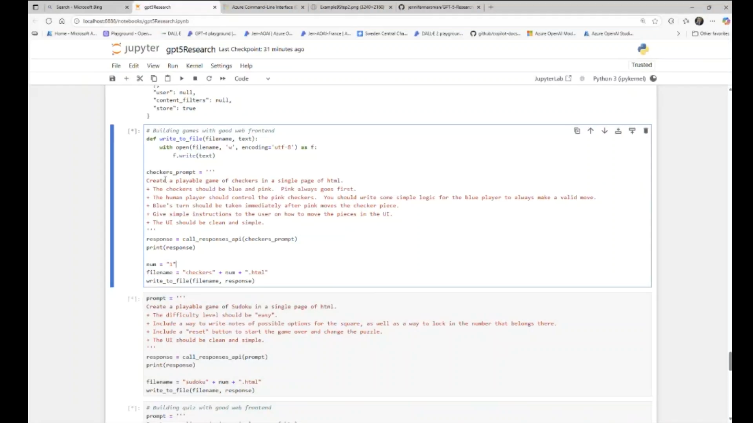
https://github.com/jennifermarsman/GPT-5-Research/blob/main/gpt5Research.ipynb

Slide 9
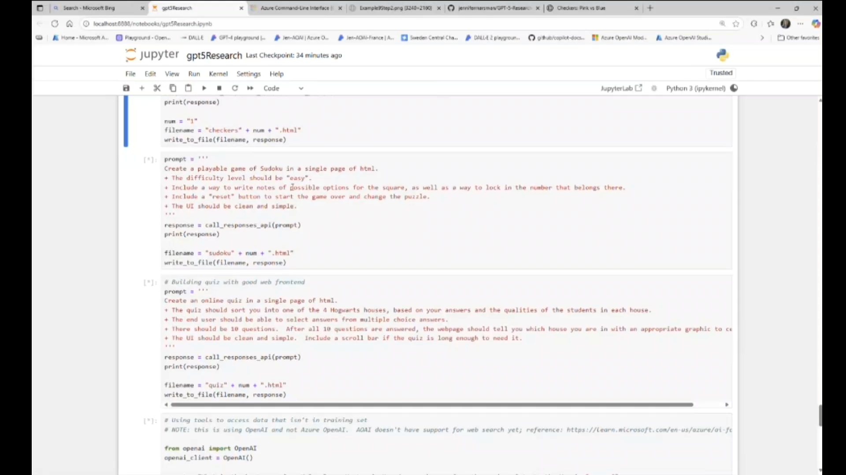

Slide 10
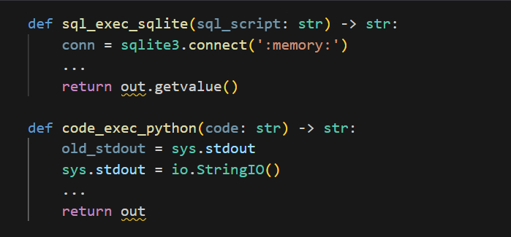
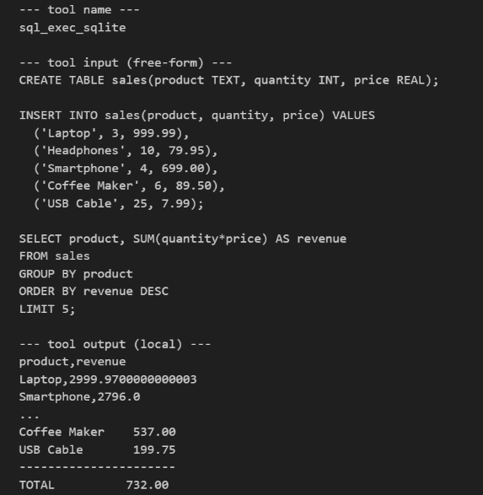
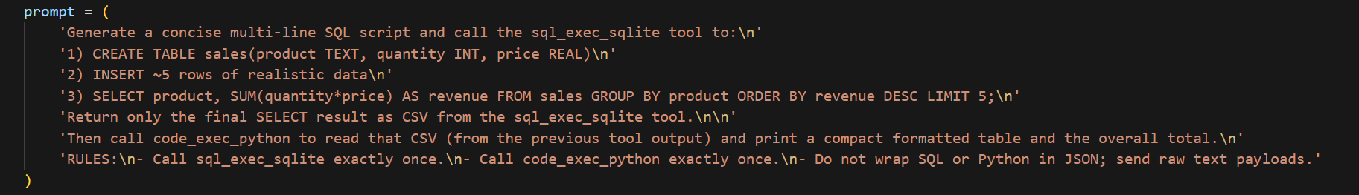
Free form tolling call with GPT-5
No JSON required: GPT-5 sends raw code directly to tools.
Natural output: Improves usability and readability.
Multi-tool orchestration: Handles complex workflows with precision.
Ideal for developers: Enables dynamic scripting, benchmarking, and automation.
https://devblogs.microsoft.com/foundry/unlocking-gpt-5s-freeform-tool-calling-a-new-era-of-seamless-integration/

Slide 11
The key things that make GPT-5 different
Reduced hallucinations: “gpt-5-main has a hallucination rate (i.e., percentage of factual claims that contain minor or major errors) 26% smaller than GPT-4o, while gpt-5-thinking has a hallucination rate 65% smaller than OpenAI o3. At the response level, we measure % of responses with 1+ major incorrect claims. We find that gpt-5-main has 44% fewer responses with at least one major factual error, while gpt-5-thinking has 78% fewer than OpenAI o3.” from GPT-5 system card
Redirect rather than refuse: From hard refusals to safe-completions: toward output-centric safety training | OpenAI
Auto model selection with model router

Slide 12
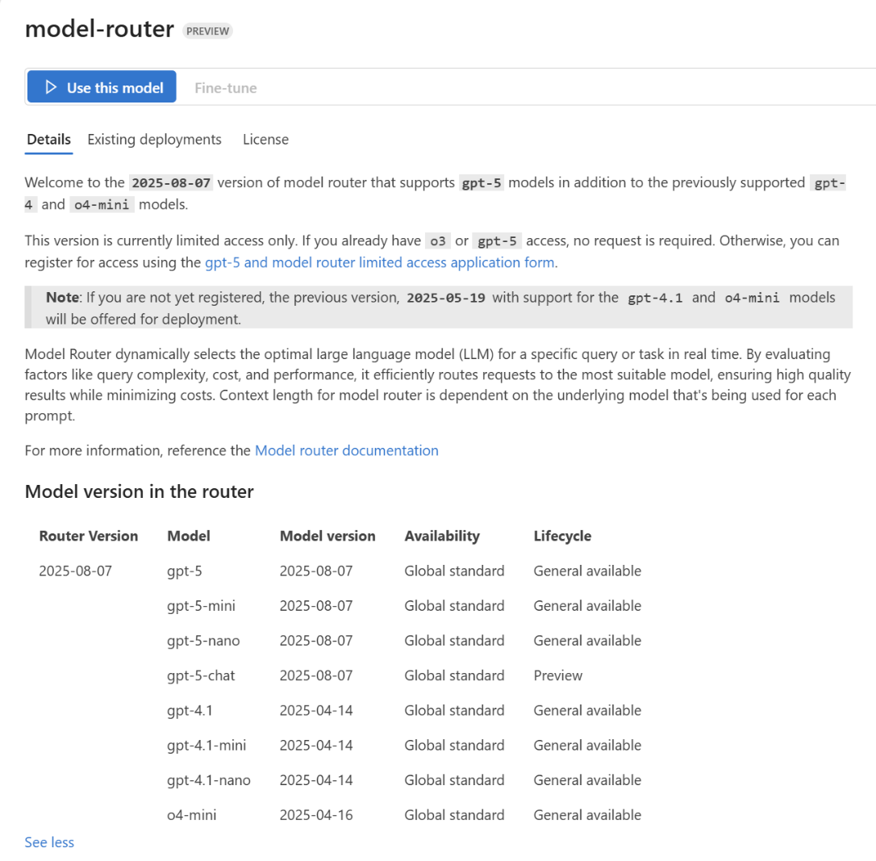
Model Router
New 2025-08-07 version includes GPT-5 models
Underlying model is not required to be deployed but model access is still required
Access request form: https://aka.ms/oai/gpt5access
https://learn.microsoft.com/en-us/azure/ai-foundry/openai/concepts/model-router

Slide 13
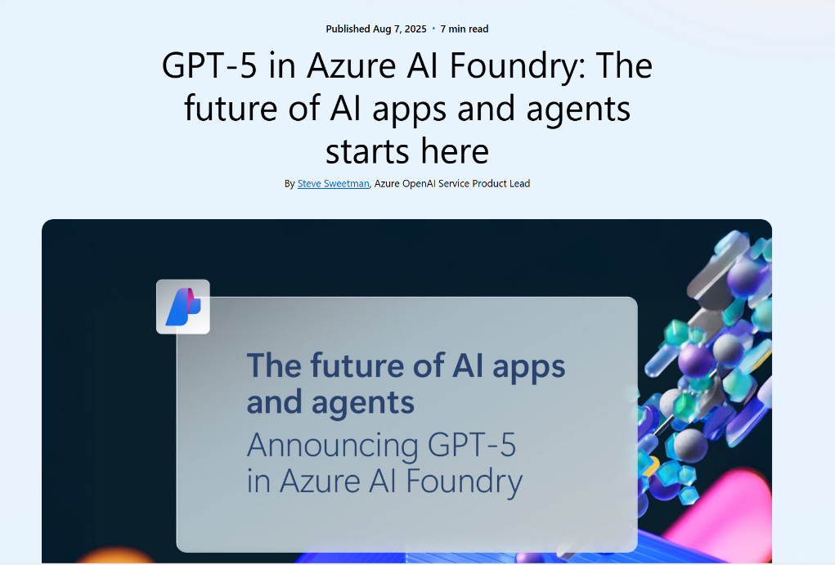
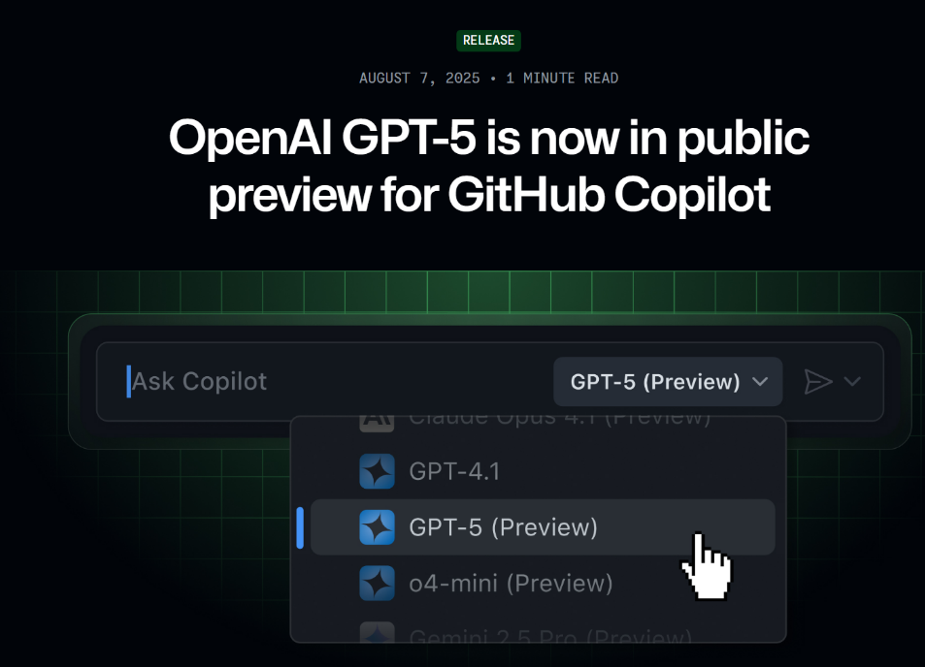
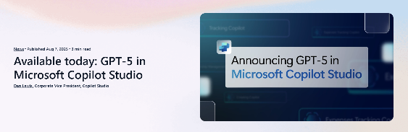
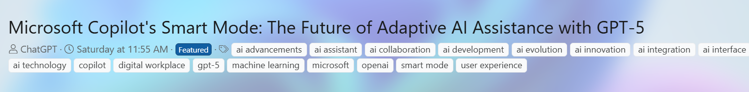
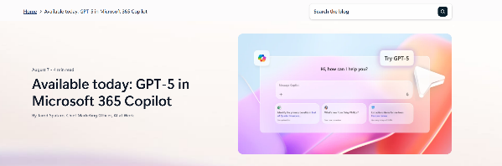
GPT 5 in Microsoft Products: Azure AI Foundry, M365, GitHub, Microsoft Copilot (MAI), M365, Copilot Studio

Slide 14
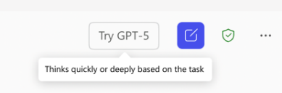
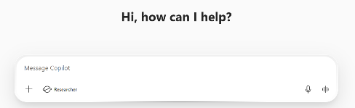
Copilot Chat powered by GPT-5
Try the latest model from OpenAI today
Copilot Chat with GPT-4o
Copilot Chat with GPT-5
GPT-5 real-time router
GPT-4o
GPT-5 High-throughput
GPT-5 Deeper reasoning
GPT-5 real-time router analyzes complexity of prompt
Simple prompts routed to GPT-5 high-throughput model
Complex prompts routed to GPT-5 deeper reasoning model
Prompt sent to GPT-4o
Both models are made secure with enterprise data protection and optimized for work

Slide 15
Copilot Chat with GPT-5 vs. Researcher
Copilot Chat with GPT-5 chooses which to use
 | GPT-5 Chat | GPT-5 Reasoning | Researcher
Type of task | Quick and straightforward: Simple Q&A, summaries, or creative brainstorming | Logical analysis and problem-solving: Complex questions that benefit from deliberate thought, reasoning through scenarios | Thorough investigations or reports: Comprehensive tasks requiring gathering and synthesizing information from lots of sources
Depth of reasoning | Direct and rapid answers | Multi-step logical reasoning for “think this through”-type prompts | Recursive, “exhaustive” reasoning for deep inferences and synthesis
Output format | Brief, concise responses | Structured, well-organized responses | Comprehensive, detailed reports
Ideal use case | Everyday queries | Analytical and structured reasoning | In-depth research, cross-source synthesis, deep dives
Example use cases | What does this acronym mean? Draft a 2-sentence reply thanking the team Summarize this document | Plan a 5-step project timeline from kickoff to launch List the decisions made yesterday on Project X and identify open questions Let’s walk through this problem together | Compile a competitive analysis on… Summarize the new research on x and compare it to our internal strategy Create a detailed brief before a large meeting
Sample prompts | “Write a short announcement for [product x].’ | “Look back at last week’s activity on [product x], and write a detailed newsletter to share with all stakeholders identifying current status, key decisions, and open items.” | “Build a full go-to-market strategy for [product x]. Include competitive positioning, internal readiness, lessons learned from past launches, and external trends.”

Slide 16
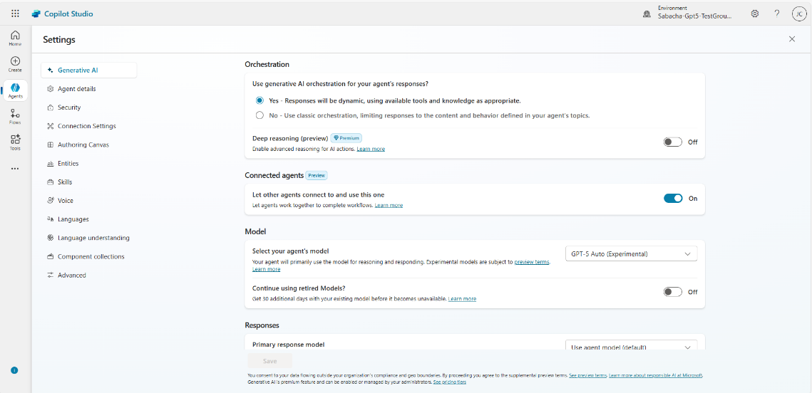
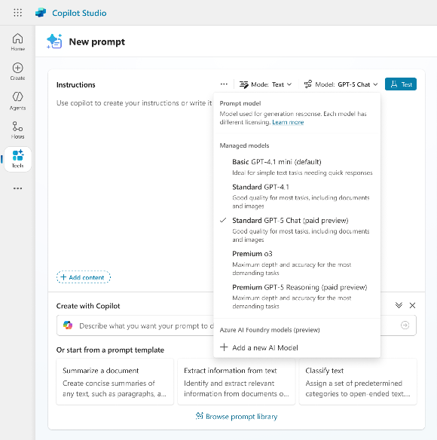
Copilot Studio
With GPT-5 model
Copilot Studio enables choosing your model and intelligent model switching for GPT-5 high-throughput and GPT-5 deep reasoning.
Agent orchestration and answer summarization with GPT-5 improves how agents interpret instructions, generate plans, use tools, and respond.
Tools like Custom Prompts use GPT-5 for faster response times, complex task planning, and improved accuracy.
Above: Copilot Studio Agent settings page with agent model selection options
Right: Custom Prompt Tools creation with model selection drop down.

Slide 17
Public Preview
Public Preview
gpt-oss-120b
Reasoning powerhouse
gpt-oss-20b
Tool savvy lightweight model
Runs efficiently on a single 80GB CPU
Excels at complex tasks like math, code, and domain-specific Q&A
Matches or exceeds OpenAI o4-mini on competition coding (Codeforces), general problem solving (MMLU and HLE) and tool calling (TauBench)
gpt-oss-120b activates 5.1B parameters per token and has 117B total parameters
Good for complex reasoning tasks, internal copilots, secure environments with data sovereignty needs
Runs efficiently on a range of Windows hardware, including discrete GPUs with 16GB+ VRAM
Delivers similar results to OpenAI o3-mini on common benchmarks
Can run on edge devices with just 16 GB of memory, making it ideal for on-device use cases, local inference, or rapid iteration without costly infrastructure
Good for on-device AI assistants, agentic tasks (code generation/execution), and scenarios with bandwidth constraints or offline requirements
Customize on your infrastructure
Agentic workflows
Strong performance at low cost
Run everywhere on cloud to edge

Slide 18
Why gpt-oss models?
Need | gpt-oss Value
Cost control | Avoids usage-based pricing; run on customer’s own infrastructure
Data sovereignty | Full control over weights + local inferencing = no data leaves customer’s perimeter
Custom use cases | Fine-tune, distill, or modify for domain-specific applications
Edge deployment | gpt-oss-20B runs on Windows machines (16GB+ VRAM); no cloud required
Security/compliance | Auditable, modifiable models for regulated industries or internal-only use
Cost control | Avoids usage-based pricing; run on customer’s own infrastructure

Slide 19
Customer Scenarios Best Suited for gpt-oss Models
Sovereign or air-gapped deployments
Customers needing explainability + full control
High-scale scenarios where usage-based pricing is cost-prohibitive
ISVs embedding AI into software that ships to customer premises
Enterprises building domain-specific copilots for internal use

Slide 20
gpt-oss Pricing
Model | Deployment Type | Input Price/ 1M Token | Output Price/ 1M Token
gpt-oss-120b (global) | Serverless | $0.15 | $0.6
gpt-oss-120b & gpt-oss-20b | Managed Compute | Pricing based on Azure Machine Learning VM type and not token used. See pricing page here.
gpt-oss-120b and gpt-oss-20b can run on NCH100 GPUs from AI Foundry

Slide 21
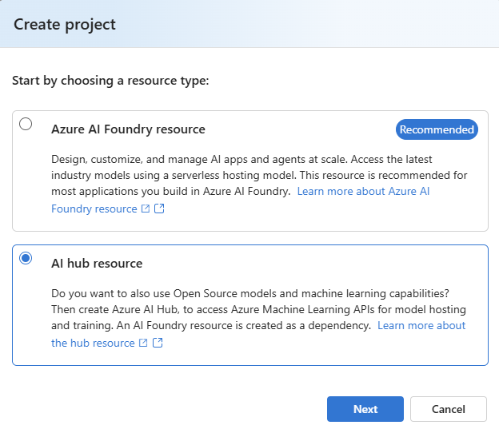
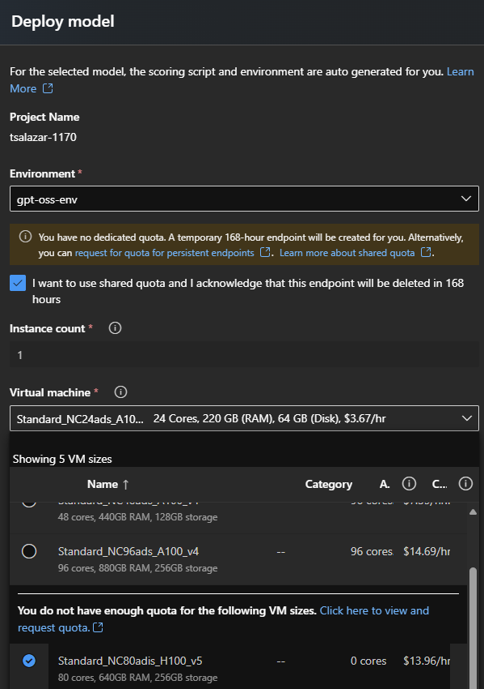
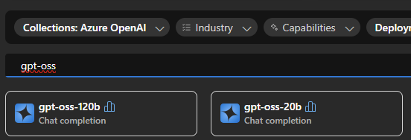
How to deploy gpt-oss with Managed Compute?
Step 1 – Create Hub resource
Step 3 – deploy as managed compute and select the compute VM
Step 2 - find the model
https://techcommunity.microsoft.com/blog/azure-ai-foundry-blog/deploying-openai%E2%80%99s-first-open-source-model-on-azure-aks-with-kaito/4444234

Slide 22



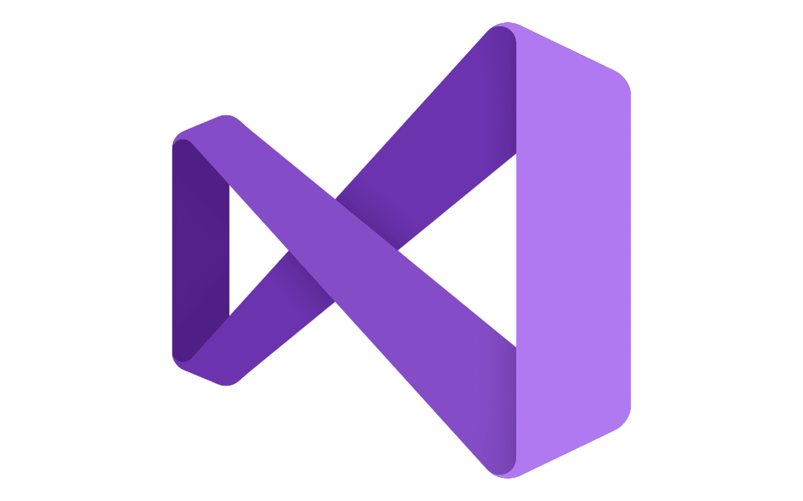







Azure AI Foundry
Copilot Studio
Foundry Models
Cloud
Visual Studio
Azure
Foundry Agent Service
Azure Arc
GitHub
Azure AI
Search
Azure AI
Services
Azure
Machine Learning
Azure AI
Content Safety
Foundry Local
Foundry SDK
Foundry Observability
Edge
Security • Identity • Management
Control
Azure Kubernetes Service
Azure App Service
Azure Container Apps
Azure Functions
Serverless

Slide 23

Simplified Setup in Foundry Project
Hub Projects
Foundry projects *New*
Foundry Resource
Project
Foundry SDK
Foundry API
Azure OpenAI
Azure OpenAI SDK
Azure OpenAI API
AI Services
Services (multi-tenant)
Hub
Various SDKs
AI Search
Connections (Optional)
Storage
Keyvault
AI Foundry
Azure OpenAI
AI Search
Option to attach
dedicated resources
Storage
Fabric
Azure Monitor
…
Many different resources and SDKs enabled scale, customization and enterprise controls but made setup and coding complicated
Simplified setup and coding, with ability to attach
dedicated resources for enterprise scale and management
https://learn.microsoft.com/en-us/azure/ai-foundry/concepts/planning

Slide 24
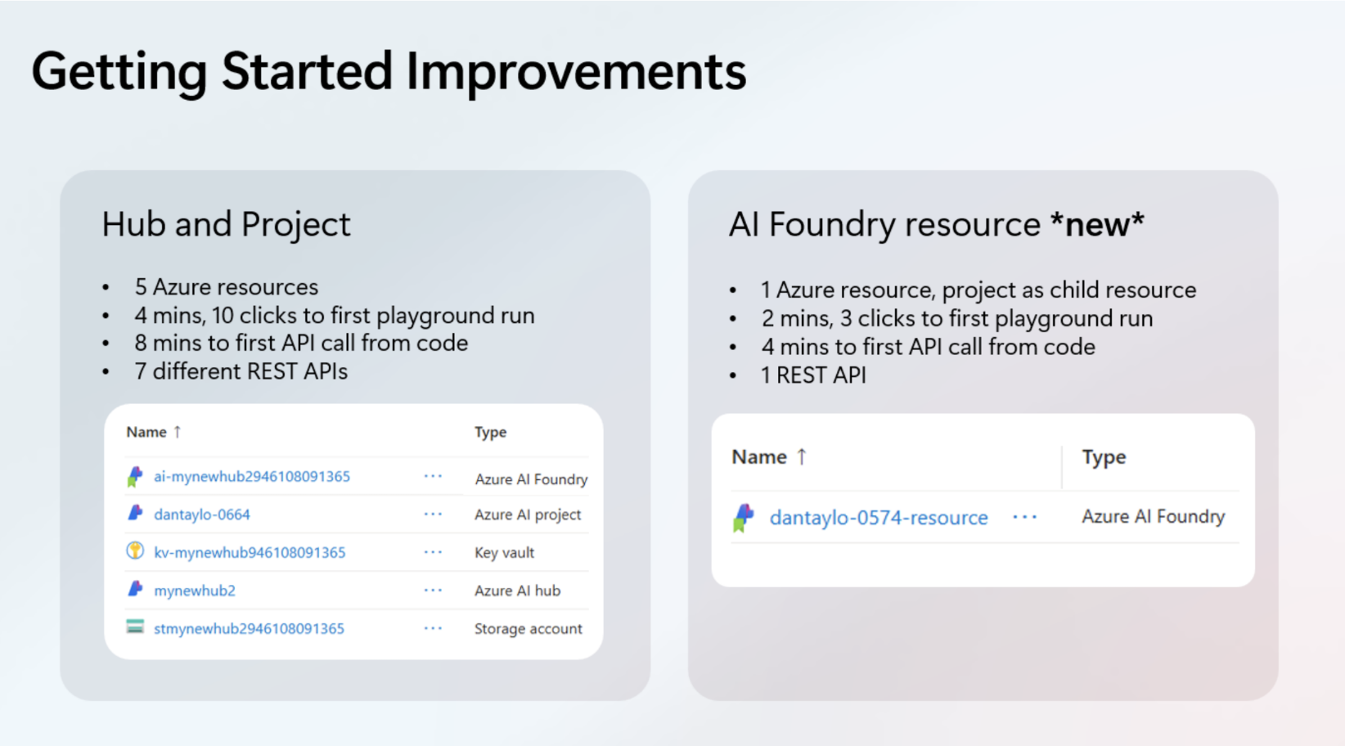

Slide 25
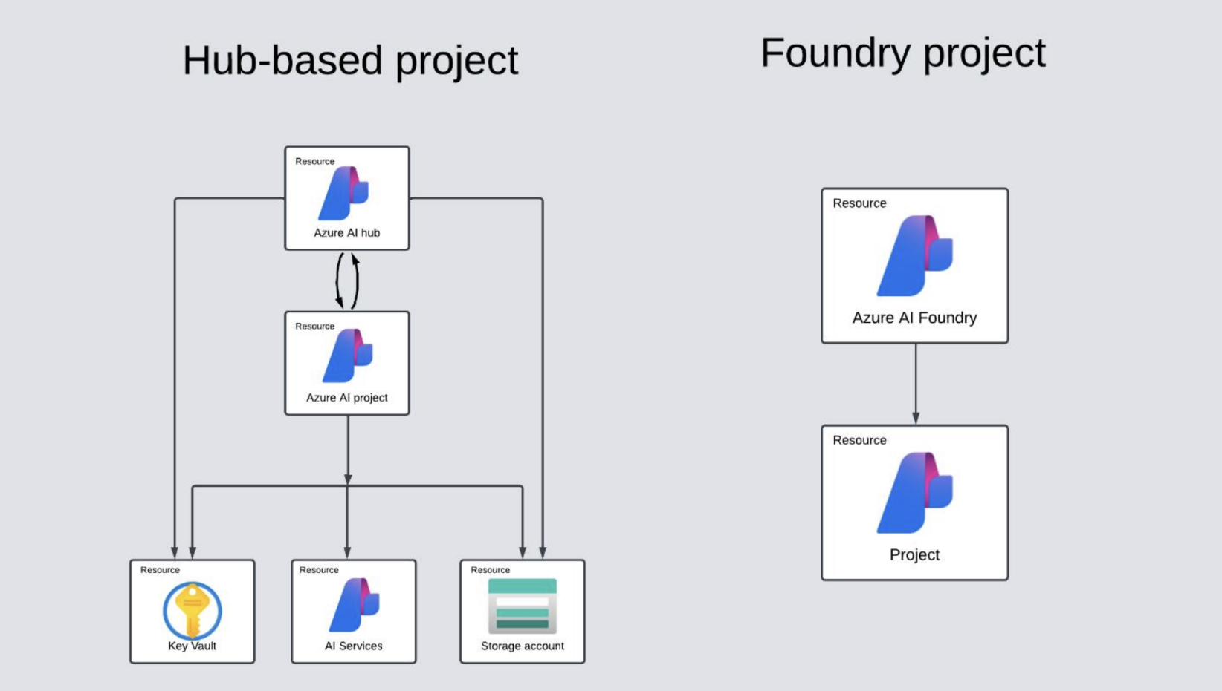

Slide 26
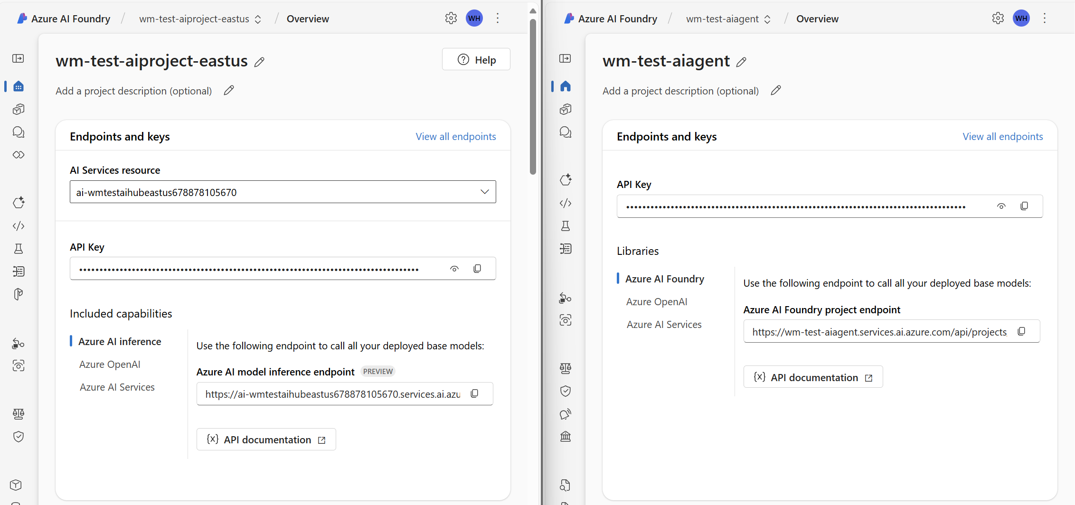
Foundry Projects
Hub-based project
Azure AI Foundry project

Slide 27
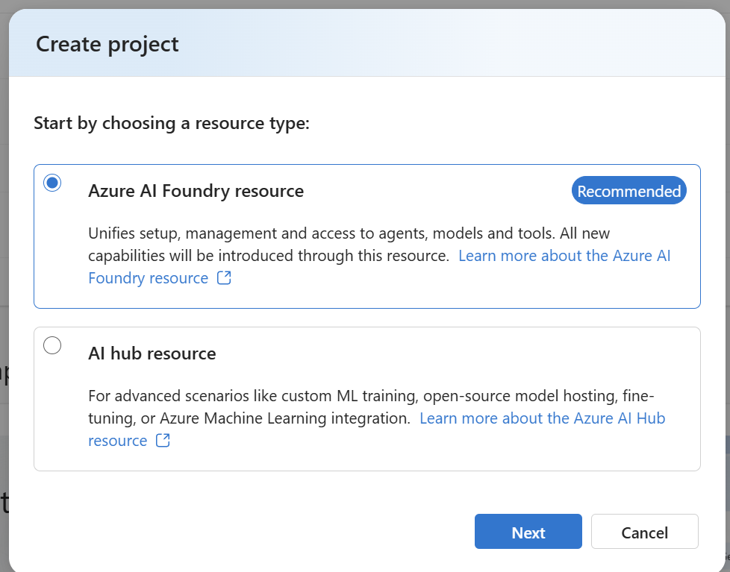
Foundry Projects
Capability | hub-based project | Azure AI Foundry project
Agents | ✅ (Preview only) | ✅ (GA)
AI Foundry API to work with agents and across models | Available via connections | ✅ (Native support)
Models sold directly by Azure - Azure OpenAI, DeepSeek, xAI, etc. | Available via connections | ✅
Partner & Community Models sold through Marketplace - Stability, Bria, Cohere, etc. | Available via connections | ✅
Open source models such as HuggingFace | ✅
Evaluations | ✅ | ✅
Playground | ✅ | ✅
Prompt flow | ✅
Content understanding | ✅ | ✅
Project files (directly upload files and start experimenting) |  | ✅
Project-level isolation of files and outputs | ✅ | ✅
Required Azure dependencies | Azure Storage account, Azure Key Vault | -

Slide 28
Azure Management Layers
Delivering management tools for AI developers, IT administrators, and operational teams.
Azure AI Foundry
Azure AI Foundry Observability
Customize
Share connections, compute, base models
Govern quota and usage
Azure portal
Platform setup
Govern security
https://learn.microsoft.com/en-us/azure/ai-foundry/concepts/architecture

Slide 29







Securing the AI Foundry environment
Network isolation
Identity & access control
Data protection
Policies & monitoring
Quota & cost management
Planning & deployment
Managed VNET, private link support, logging
Managed identity,
AAD, RBAC, ABAC
Microsoft-managed
Or Customer-managed keys TLS1.2
Azure Monitor & audit logs. Azure Policy
Budgeting, auditing, and shared quota tools
ARM / Bicep / Terraform code templates for infra
Platform trust
Data protection, GDPR compliance, transparency on OS/container updates, and vulnerability management

Slide 30
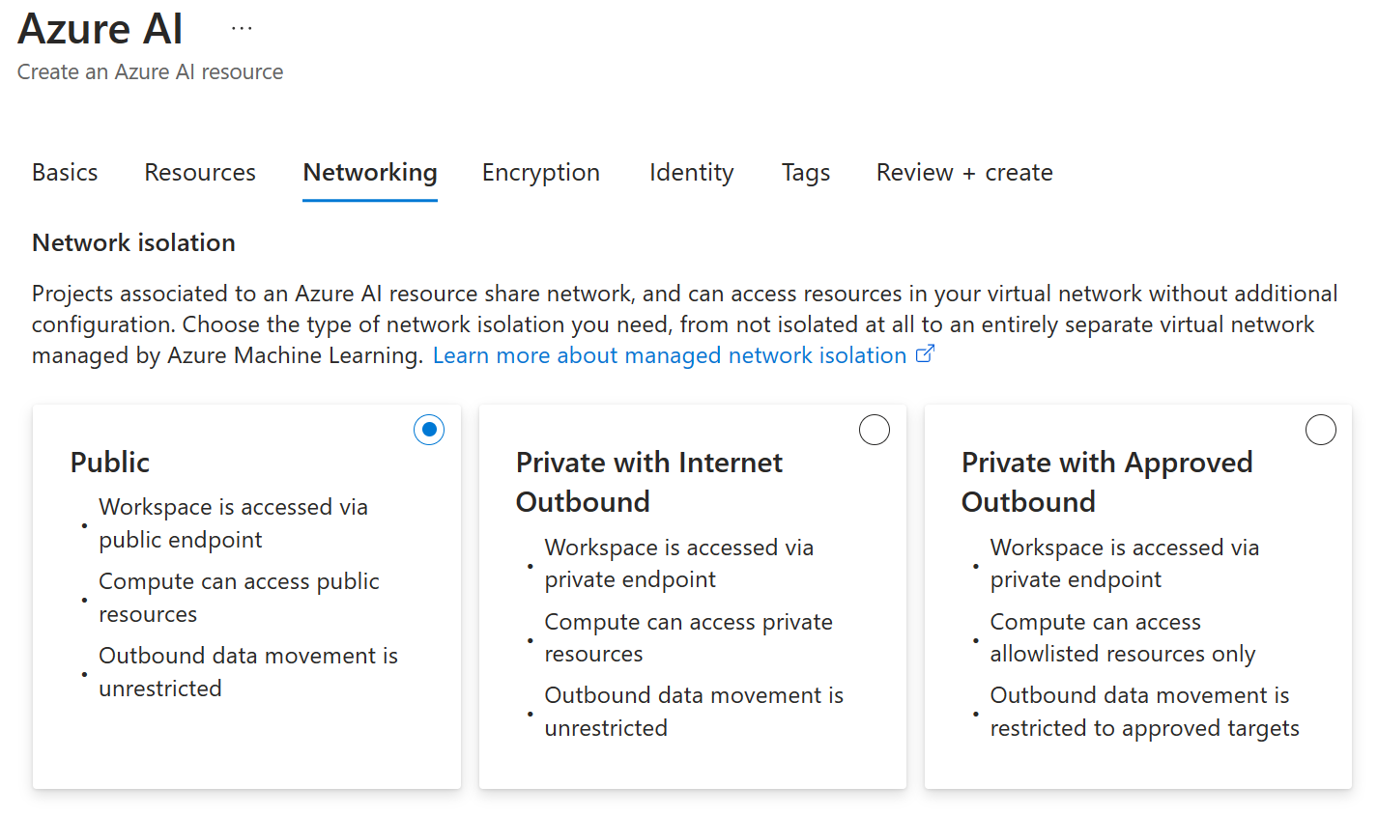
Network isolation in Foundry Observability
Secure your workspaces and compute resources.

Slide 31













Network isolation in Foundry Observability
Managed VNet
Azure AI Foundry
Compute instance
Serverless
Managed online endpoint
AI project
Private endpoints
AI hub
Your Azure VNet
Blob
File
Azure
Storage Account
Azure
Key Vault
Azure AI Search/Azure OpenAI
Private endpoints
Bastion with jump box VM
ExpressRoute
VPN Connection
Azure
Container Registry (Optional)
Azure AI Services
(optional)
On premises
network
Azure AI connected resources

Slide 32

Credential-less support for storage
Managed VNet
Azure AI Foundry
Compute instance
Managed online endpoint
Serverless
AI project
Private endpoints
AI hub
Your Azure VNet
Blob
NEW
Private endpoints
File
Azure
Storage Account
Azure
Key Vault
Azure Container Registry (optional)
Bastion with jump box VM
ExpressRoute
VPN Connection
NEW
Azure AI Services
Azure
OpenAI
Azure AI Search
(optional)
On premises
network
Azure AI connected resources

Slide 33
Identity and Access Control in Foundry Observability
Assign and manage RBAC.
Sample enterprise RBAC setup
Persona | Role | Purpose
IT admin | Owner of the Azure AI hub resource | The IT admin can ensure the Azure AI hub resource is set up to their enterprise standards and assign managers the Contributor role on the resource if they want to enable managers to make new Azure AI hub resources or they can assign managers the Azure AI Developer role on the resource to not allow for new Azure AI hub resource creation.
Managers | Contributor or Azure AI Developer on the Azure AI hub resource | Managers can manage the AI hub, audit compute resources, audit connections, and create shared connections.
Team lead/Lead developer | Azure AI Developer on the Azure AI hub resource | Lead developers can create projects for their team and create shared resources (ex: compute and connections) at the Azure AI hub resource level. After project creation, project owners can invite other members.
Team members/developers | Contributor or Azure AI Developer on the Azure AI Project | Developers can build and deploy AI models within a project and create assets that enable development such as computes and connections.

Slide 34
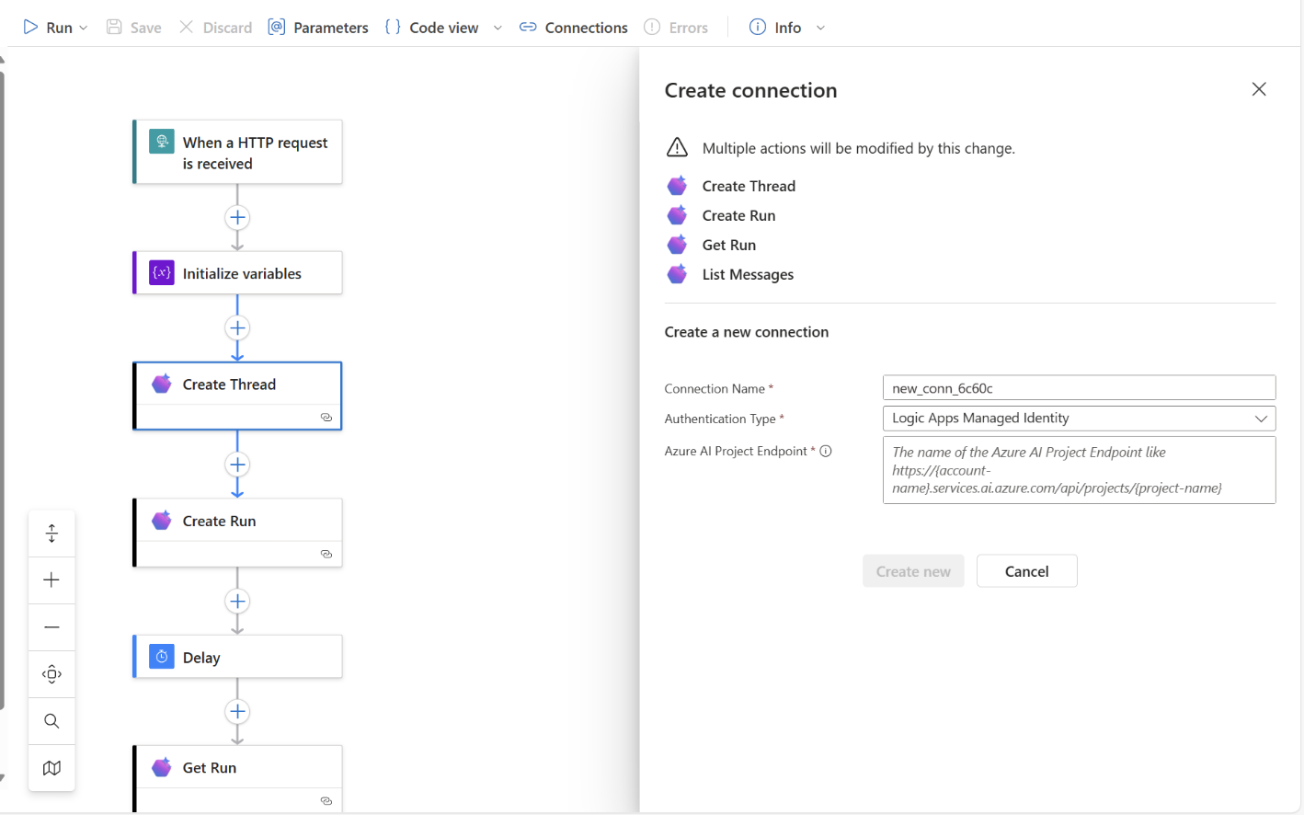
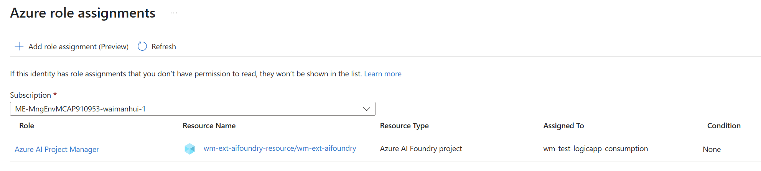

Slide 35
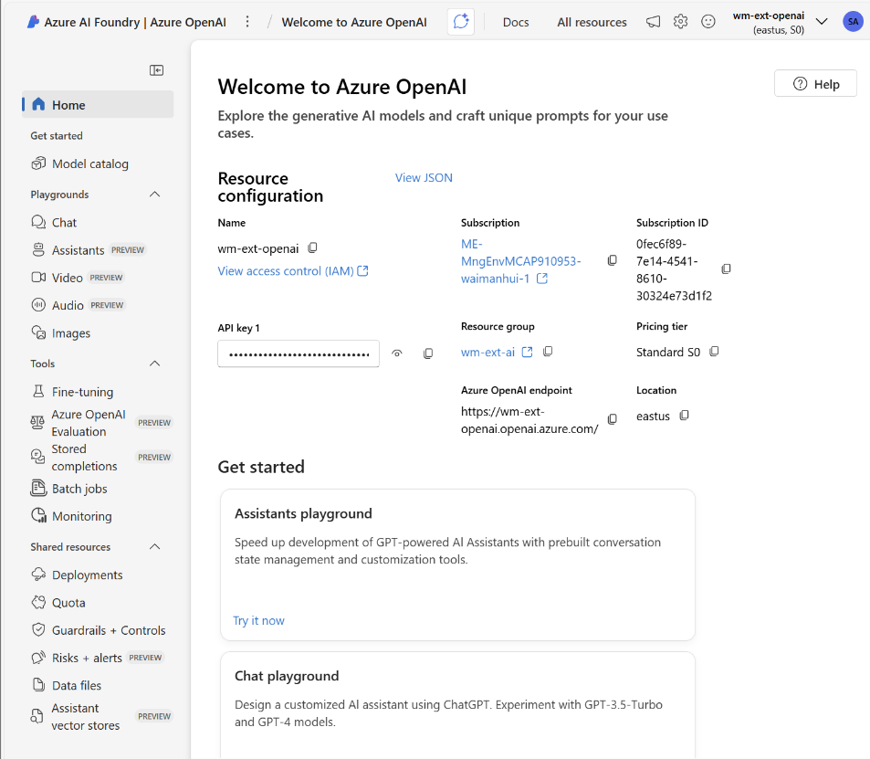
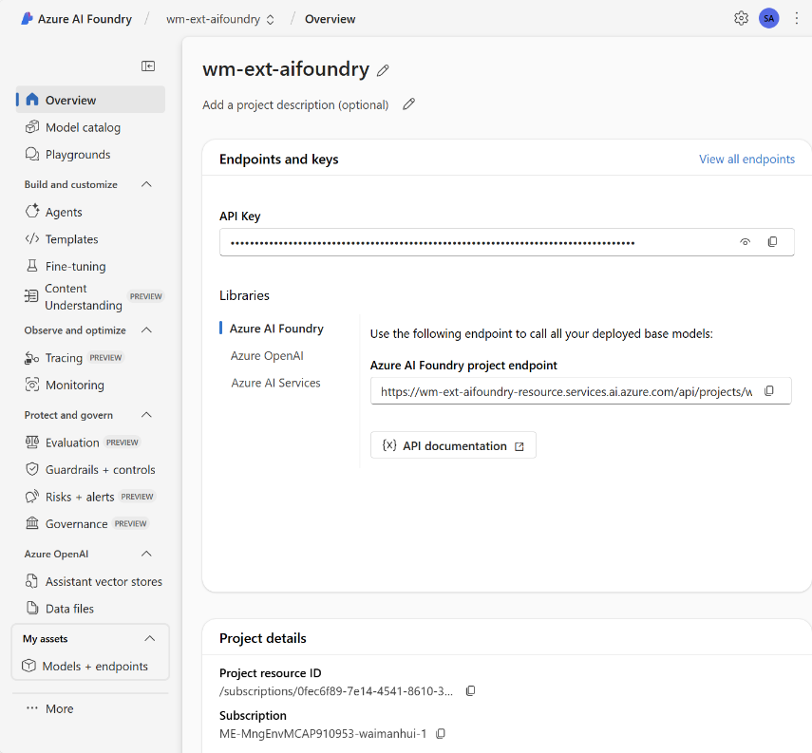
Azure OpenAI vs AI Foundry

Slide 36
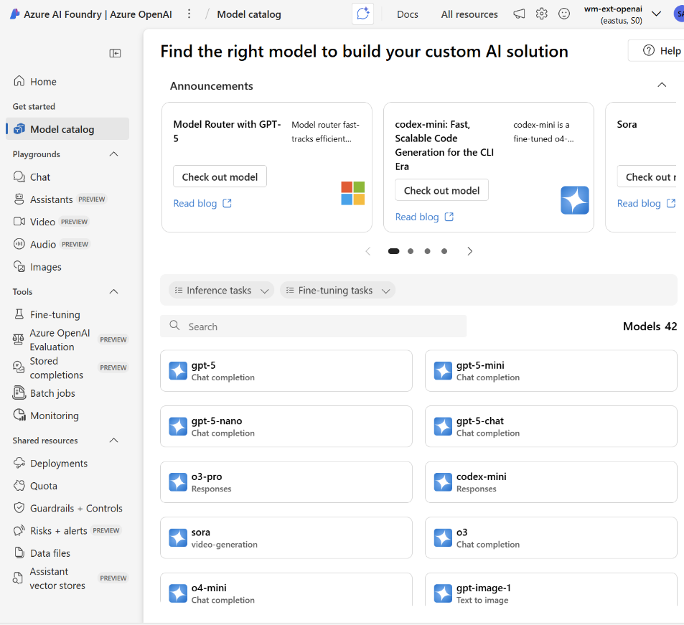
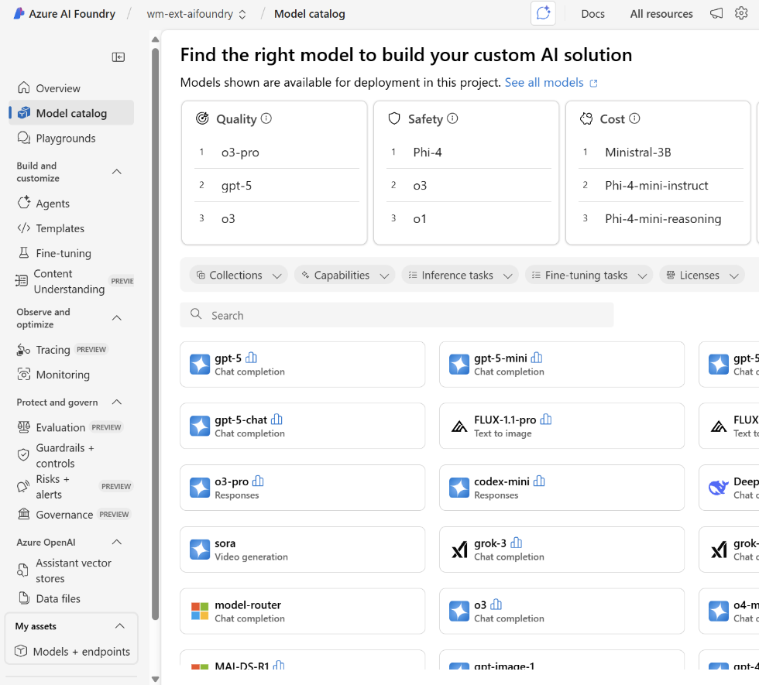
Azure OpenAI vs AI Foundry

Slide 37













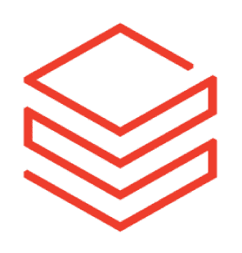







Azure AI Foundry Models
Offering 11,000+ frontier and open models
Hosted and sold by Microsoft
Other Foundry Models
Deployment Type: Standard
Managed Compute
Deployment Locations: Global
7 Regions
Sold by:
Partner
Built-in safety
Deployment Types:
Standard Provisioned Throughput
Batch (50%off)
Deployment Locations: Global
Data Zone (US and EU)
28 Regions Sold by: Microsoft
OpenAI Model Family
(available day 1)
DeepSeek latest
Mistral AI latest
Hugging Face
NVIDIA
NIMS
Cohere
Specialized & Industry models
Meta Llama
latest (coming soon)
xAI
Grok
Black Forest
Labs
Microsoft Phi Family

Slide 38



Azure AI Foundry SDK streamlines development
Create an
AI project to connect services and data
Use a common inferencing API for Azure AI Foundry Models
Unlock insights with Azure AI Foundry Agent Service
Deploy apps to Azure using pre-built AI templates
Automatically take actions, including self-correct
Integrate your existing data and services (Bing Search, Azure AI Search, Microsoft Sharepoint, Microsoft Fabric)

Slide 39
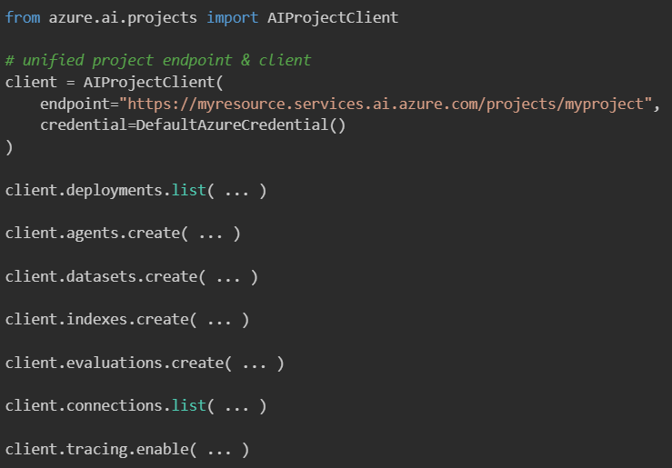
Azure AI Foundry API
Clients
Foundry portal
Foundry SDK
GitHub
VS Code
Foundry API
Models
Agents
Datasets
Indexes
Capabilities
Evaluation
Tracing
Connections
Fine-Tuning (coming soon)
Shared Service Layer
Azure Service Layer
Connections
External Resources
Compute
Storage
Data
Identity
App Hosting
AI Services
Image may not reflect actual user interface.

Slide 40




























Deploy your AI application in production
3
4
Azure AI Foundry-hub workspace Managed Virtual Network
Client Applications
Managed online endpoint
Managed compute
Managed Identities
Azure AI Foundry
App Service Environment
App Service
App Service
Managed Identity
Private Endpoints
Client
------------
----
----
Zone 1
------
Azure Monitor
Storage Account
Key Vault
Container Registry
Azure AI Services
Application Insights
Log Analytics
Azure OpenAI
Azure AI Search
Azure SQL
Cosmos DB
App Storage Account
Foundry project
App Service Environment
External APIs
5
private DNS zones
linked
Private Endpoints
API Management
portal, c--, c----
Jumpbox VPN
apim-subnet
VipSubnet
Managed Identities
2
Bastion Host
Application Gateway
DDoS protection
AzureBastionSubnet
gateway-subnet
Client
------------
Client Virtual Network
Public IP Address
Machine Learning Administrators and Data Scientists
1
https://github.com/microsoft/Deploy-Your-AI-Application-In-Production

Slide 41


Model Customization Options in Azure AI Foundry
high
06
Continuous improvement
signal loop
Fine-tuning/distillation in Azure AI Foundry
05
Fine-tuning/ RAFT
Foundry Observability
04
Feedback/signals
Azure AI Search
Foundry Agent Service
Business Value
03
Rag/tool calling
Multi-agents
Prompt engineering
Declarative agents
02
Azure AI Foundry Agent Service
Base model
01
Azure AI Foundry Models
low
high
Maturity of Model Adaptation

Slide 42
Agentic AI to erase developer toil at scale
Pain that steals developer time | Why it’s hard without AI
Unstructured content glut (audio, video, docs) | Manual search/transcription; brittle regex
Repetitive knowledge packaging | Copy-paste drudgery, style drift
Reference / link curation | Scattered sources, stale links
Metadata upkeep | Hand-entered bios, errors
Quality & compliance checks | Spot-checking by humans
Analytics & feedback loops | Siloed dashboards
What an agentic pattern unlocks
Multimodal + speech agents auto—ingest & label
LLM-powered compose agents with brand guardrails
Retrieval-augmented agents pull fresh, deduped refs
Knowledge-graph agent enriches & re-uses data
Policy-enforcing guard-agents catch issues early
Observability agent emits unified metrics, auto-tunes prompts

Slide 43
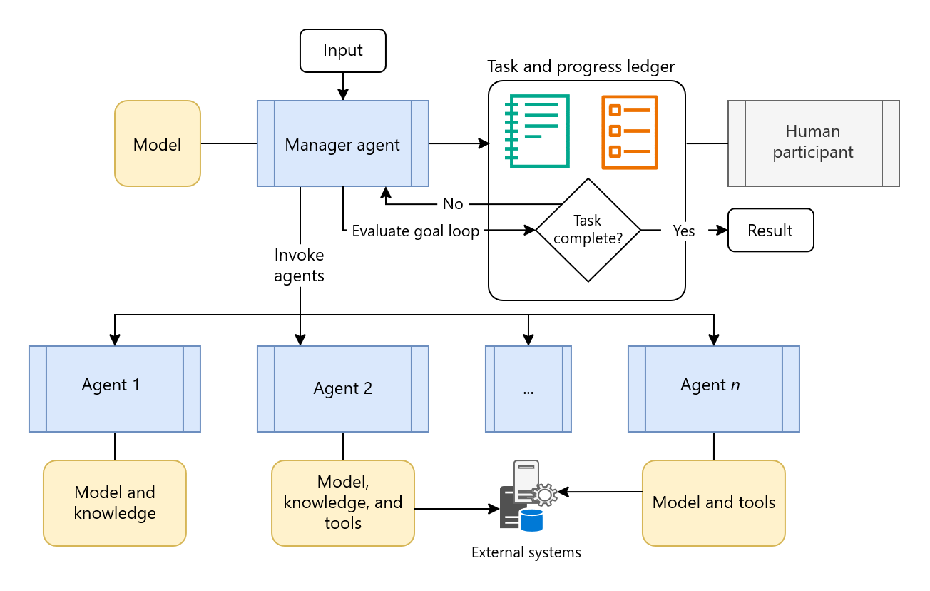
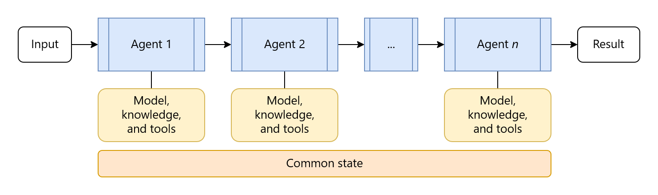
AI Agent Orchestration Patterns
https://learn.microsoft.com/en-us/azure/architecture/ai-ml/guide/ai-agent-design-patterns
This guide covers fundamental orchestration patterns for multi-agent architectures and helps you choose the approach that fits your specific requirements.
Sequential orchestration
Concurrent orchestration
Group chat orchestration
Handoff orchestration
Magentic orchestration
Sequential orchestration
Magentic orchestration

Slide 44






End-to-end observability and simplified governance
Observability tools
Model selection & evaluation
Monitoring & improvement
Evaluation
Prompt management
Experimentation
Monitoring
CI/CD Automation
Tracing & Debugging
Foundry Observability + Azure Monitor
Foundry Observability
Governance tools
Projects
Connected Resources
Models & endpoints
Users
Quota
Compute
Microsoft Entra
Microsoft Defender
Microsoft Purview
Azure Policy

Slide 45









Achieve more with Microsoft Fabric and Azure AI Foundry
Microsoft Fabric
Azure AI Foundry
Data Science
Fabric data agents
Azure Machine Learning
Azure AI Foundry
Agent Service
Azure AI Search
Your unified solution for analytics
Your genAI that enhances data interaction
Your end-to-end, managed ML platform
Your search index which streamlines RAG
Your suite of tools to develop enterprise agents
OneLake
Microsoft Purview

Slide 46
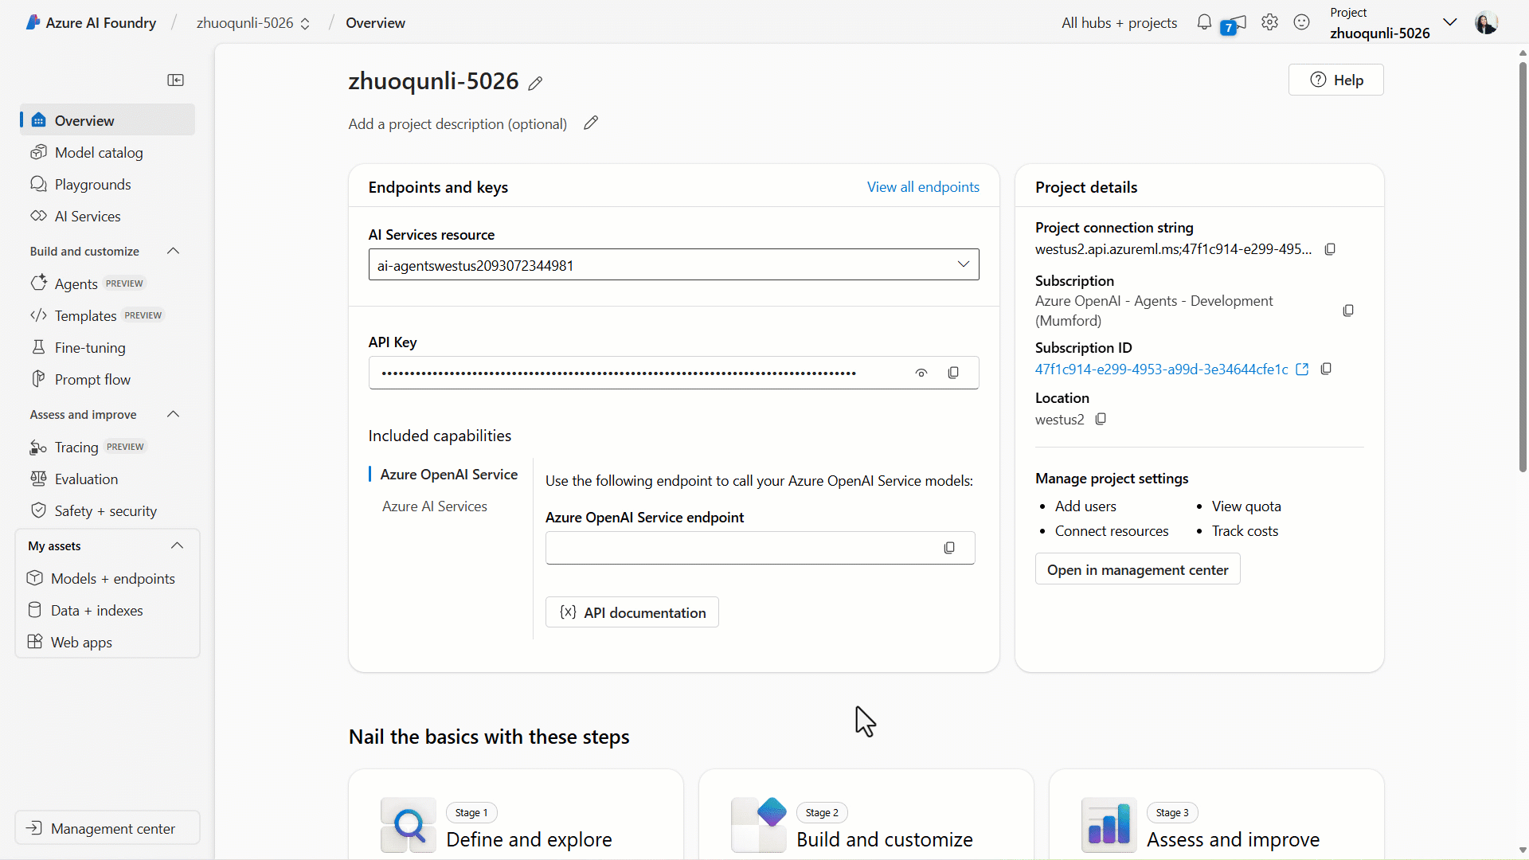
Fabric integration with Azure AI Foundry
Build accurate, relevant, and context-aware multi-agent solutions
Public Preview
Fabric data agents can reason over and synthesize data in OneLake for insights
AI creators can enrich AI agents in Azure AI Agent Service with Fabric data agents' expertise
Security permissions, including RLS and CLS, are respected

Slide 47











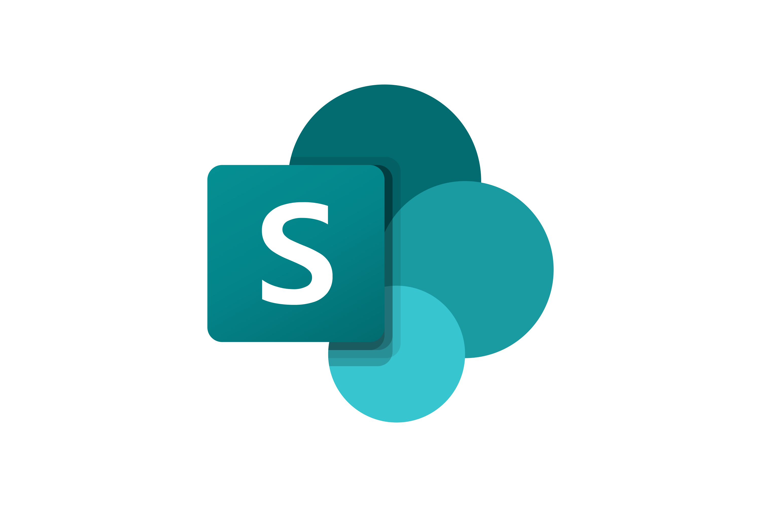




Azure AI Foundry charts
Azure AI
Foundry
Foundry Agent Service
Agent Catalog Managed Service Managed Memory
Auth integration
Code execution
File Search
Agent protocols & APIs
Assistants API
Responses API
Activity Protocol
A2A*
Agent Protocol*
Agent frameworks
Agents SDK Semantic Kernel
AutoGen
LangGraph
LangChain
LlamaIndex
Crewai
…
Foundry Observability
Logging & Tracing
Monitoring
Evaluation
Experimentation
Network isolation
Identity
Access control
Data protection
Policies
Compliance
Cost management
Governance
Tools
Custom Tools
OpenAPI tools
MCP tools
Built-in tools
Bing
Azure AI Search
SharePoint
Microsoft Fabric
Cosmos
Logic Apps
Azure Functions
Azure AI Content Safety
Enterprise Security
Risk & Safet Evaluations
Prompt Shields
Groundedness Detection
Foundry Models
Azure OpenAI
Microsoft Phi
Others
Foundry Local
Fine-tuned models
BYO models

Slide 48
Build Agentics Application in Azure AI Foundry Agent Service
Kinfey Lo | Microsoft Senior Cloud Advocate

Slide 49
AI
AI factory

Slide 50
Azure AI Foundry
Copilot Studio
Foundry Models
Cloud
Visual Studio
Azure
Foundry Agents
Azure Arc
GitHub
Azure AI
Search
Azure AI
Services
Azure
Machine Learning
Azure AI
Content Safety
Foundry Local
Foundry SDK
Foundry Observability
Edge

Slide 51
Azure AI Foundry
Copilot Studio
Foundry Models
Cloud
Visual Studio
Foundry Agents
Azure
Foundry Agents
Azure Arc
GitHub
Azure AI
Search
Azure AI
Services
Azure
Machine Learning
Azure AI
Content Safety
Foundry Local
Foundry SDK
Foundry Observability
Edge
Security & Governance

Slide 52







What is an agent?
Agent
LLM
LLM
Input
Output
Instructions
Instructions
Tools
System events
User messages
Agent messages
Tools
Agent messages
Tool results
Tool calls
Retrieval
Actions
Memory

Slide 53
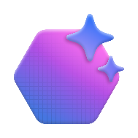





Multi-agent orchestration
Connected agents
Multi-agent workflows
Powered by Semantic Kernel
Give one agent the abilities of another.
Declaratively orchestrate multiple agents.

Slide 54

Hanselminutes podcast factory
20 years, 990+ podcast episodes, ~1000 hours of raw audio
Voice-enabled orchestrator
Guest intake
Packaging
Promotion
Guest sourcing
Transcript generator
Show notes generator
Social copy generator
Content localizer
Bio generator
Scheduler
Link resolver
Scheduler

Slide 55





Building agents your way
Platform integrations, ease-of-use, and development speed
PaaS
PaaS
SaaS
IaaS
SaaS
IaaS
Infrastructure-as-a-service
Infrastructure-as-a-Service
Platform-as-a-Service
Platform-as-a-service
Software-as-a-Service
Software-as-a-service
Code handling every detail
Code with managed services
Drag and drop UI building
Azure AI Infrastructure
Azure AI Foundry
Copilot Studio
Bring your own frameworks
Foundry Agent Service
Instant agent runtime
Control, visibility, and customization

Slide 56

Azure AI Foundry Agent Service
Azure AI Foundry
BRK149
Generally available. Orchestrate and host single and multi-agent workflows.
Multi-agent workflows
Open & interoperable tooling
Trust & enterprise
security

Slide 57











The full enterprise package
Azure AI Foundry Agent Service
Trust
Choice
Tools
Customer control over data, networking, and security
Model choice and flexibility with Foundry Models
Richest set of enterprise connectivity
BYO-file storage
BYO-search index
BYO-virtual network*
BYO-thread storage*
Auth integration
Knowledge
Azure OpenAI
GPT-4o, GPT-4o mini, etc.
Llama 3.1-405B-Instruct
Mistral Large
Cohere-Command-R-Plus
Actions
Logic Apps*
Azure functions
OpenAPI

Slide 58
Foundry Agents Service Interop
Import external agents
Expose your agent externally
Assistants API
Assistants API
Responses API*
Responses API✧
Activity protocol*
Activity protocol✧
A2A*
Azure AI Foundry
A2A
Agent protocol✧
Agent protocol✧
MCP*
MCP*
* Available with Semantic Kernel
✧ Coming soon

Slide 59

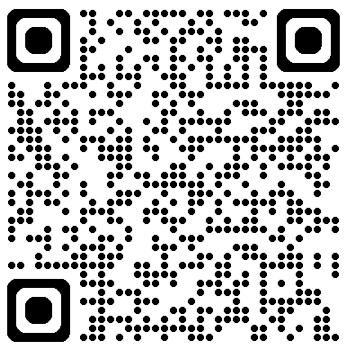
Microsoft Cloud & AI Bootcamp
A digital experience is designed to accelerate your AI ambitions, from strategy to secure, scalable execution.
Leading in Age of AI | Architecting Scalable, Intelligent AI systems | Building & Scaling AI Apps + Agents | Migrate & Modernise
For CxOs, Business, and Technical Decision Makers defining AI strategy. | For IT Pros and Technical Decision Makers building secure, scalable AI. | For Developers eager to advance with the latest tools. | For IT Decision Makers and IT Pros adopting AI-ready, secure infrastructure.
Competing in the Age of Intelligence | Microsoft AI Horizons - Season 3 of AI | New Agentic Development World | Migrate and Modernise Your Estate for AI Innovation
Leading the AI Shift | Fuelling Intelligent Systems - Data Readiness for AI | AI-Accelerated Developer Tools and Platforms | Accelerate AI Innovation on a proven platform for Linux
Executive AI Briefing: Inside Microsoft’s Customer Zero Playbook | Automation vs. Intelligence - Where Do AI Agents Fit | Building World Class Cloud and AI Platform with Cloud Native and AKS | End-to-End AI Innovation: Embedding AI in Every Step
How businesses can unlock business and financial benefits in the Age of AI | Microsoft Datacenters: Illuminating the Unseen Power of the Cloud | Fireside Chat: Next-gen AI Developer
 | Ultimate Guide to Navigate the Latest AI Models on Azure | Build AI Agents in Azure AI Foundry
View On Demand
https://www.microsoft.com/en-hk/CloudandAIBootcamp/

Slide 60
Thank you

