Slide 1
Boost Developer Productivity with GitHub and Azure
Wai Man Hui - Microsoft Cloud Solution Architect, Microsoft
Kinfey Lo - Microsoft Senior Cloud Advocate, Microsoft
Ken Lin - MCT Regional Lead, MCT Community Lead
Microsoft MVP 2003-2017

Slide 2
Agenda
What’s news in Azure AI
GitHub platform overview
Working with MCP
Working with GitHub Copilot Agent mode

Slide 3
Public Preview
GPT-image-1
Granular Instruction Response:
Excels at understanding and executing detailed instructions, ensuring precise and accurate image generation
Text Rendering:
Renders reliable text within images, enhancing utility in creating educational materials and storybooks
Image Input Acceptance:
Allows upload of user images and provision of text prompts to generate new images or edit existing ones, offering a versatile tool for creative projects
Granular Instruction Response
Reliable Text Rendering
Image Input Acceptance
Image-to-image Prompting

Slide 4
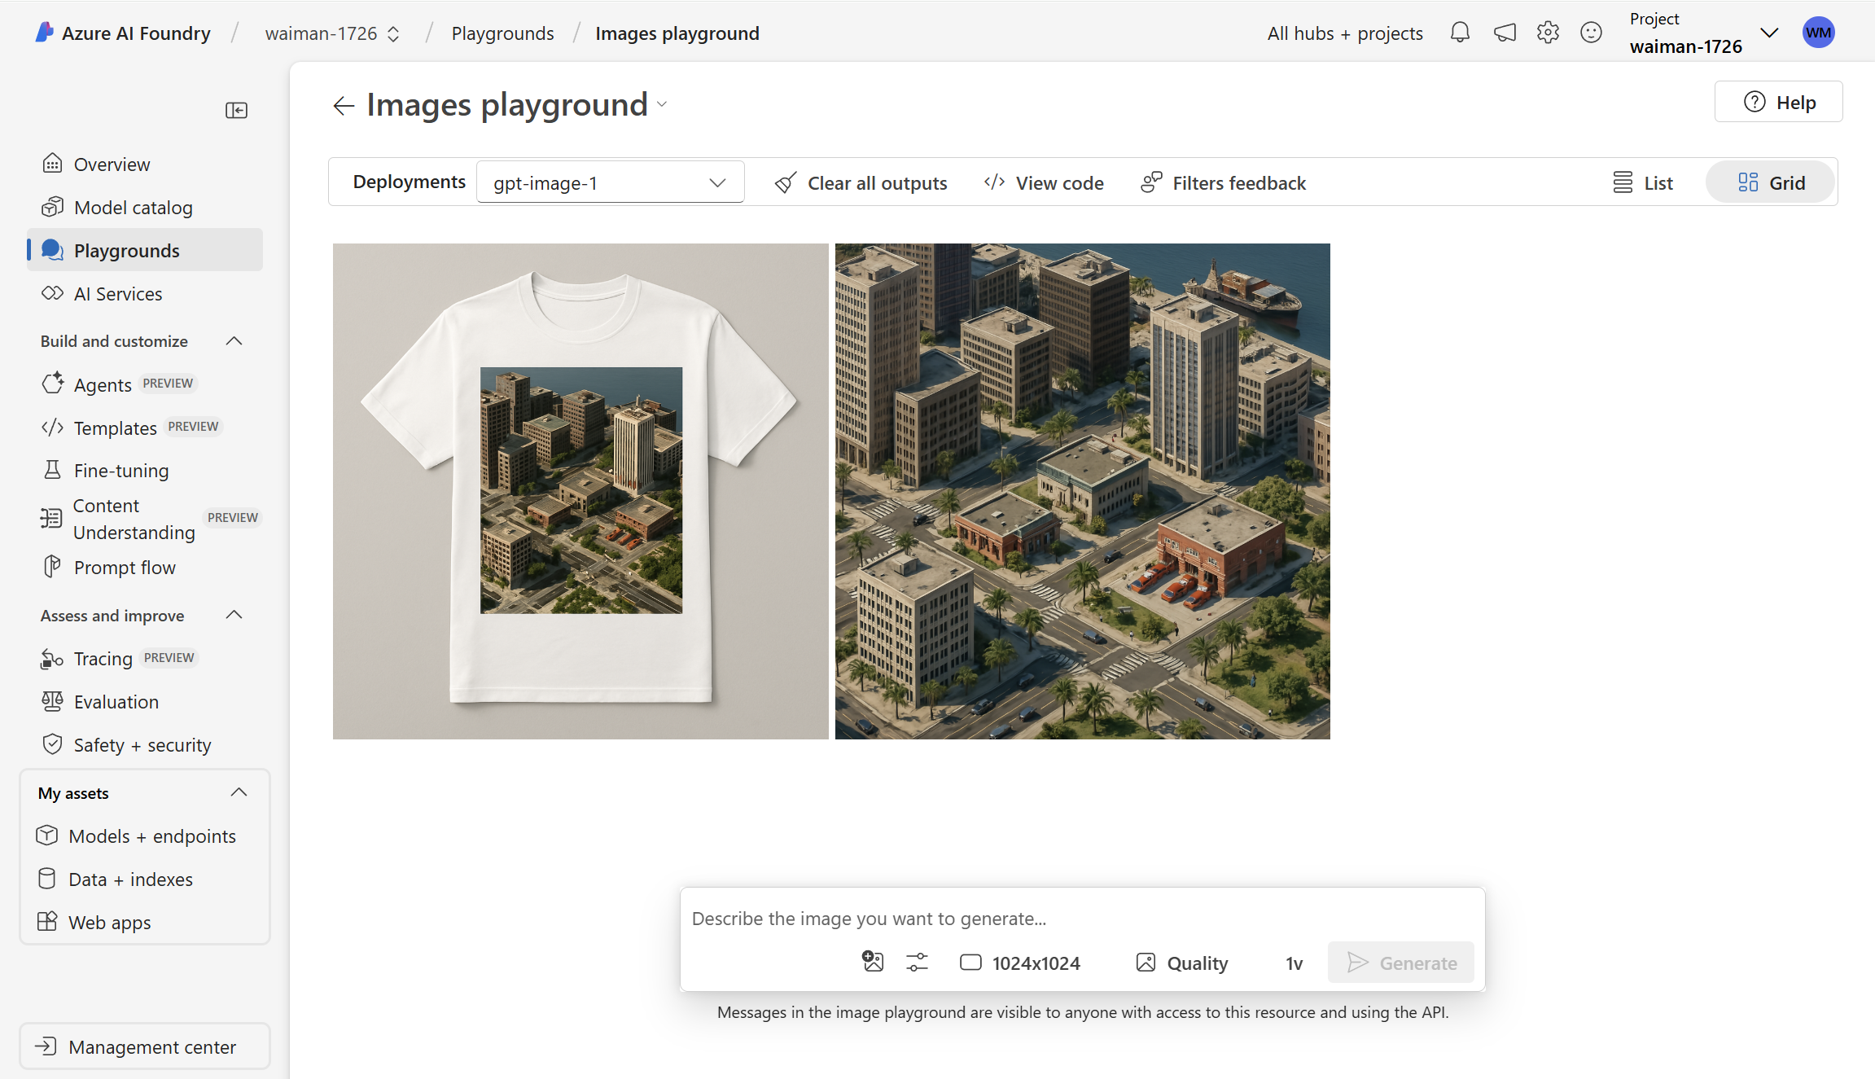
Generate a super realistic 3D view of a city on an island for my city simulation game. It should show a downtown view of a city criss-crossed with a regular street grid, with cars and people going about their day. create realistic office buildings, police station, fire station, port. Make it look like a middle of a sunny day. Make sure the geometry of street and buildings is correct and rendered in isometric projection. Make sure the textures and lighting of the buildings is realistic. Add palm trees and some parks.
Generate a picture of a T-shirt that would go well with this landscape

Slide 5
Azure OpenAI Audio Models
Public Preview
Advanced audio processing and content generation
GPT-4o-transcribe
Speech-to-Text
GPT-4o-mini-transcribe
Speech-to-Text
GPT-4o-mini-tts Text-to-Speech
https://devblogs.microsoft.com/foundry/get-started-azure-openai-advanced-audio-models/

Slide 6
Azure OpenAI Audio Models
Feature | GPT-4o-Transcribe | GPT-4o-Mini-Transcribe | GPT-4o-Mini-TTS
Performance | Best Quality | Great Quality | Best Quality
Speed | Fast | Fastest | Fastest
Input | Text, Audio | Text, Audio | Text
Output | Text | Text | Audio
Streaming | ✅ | ✅ | ✅
Ideal Use Cases | Accurate transcription for challenging environments like customer call centers and automated meeting notes | Rapid transcription for live captioning, quick-response apps, and budget-sensitive scenarios | Customizable interactive voice outputs for chatbots, virtual assistants, accessibility tools, and educational apps

Slide 7
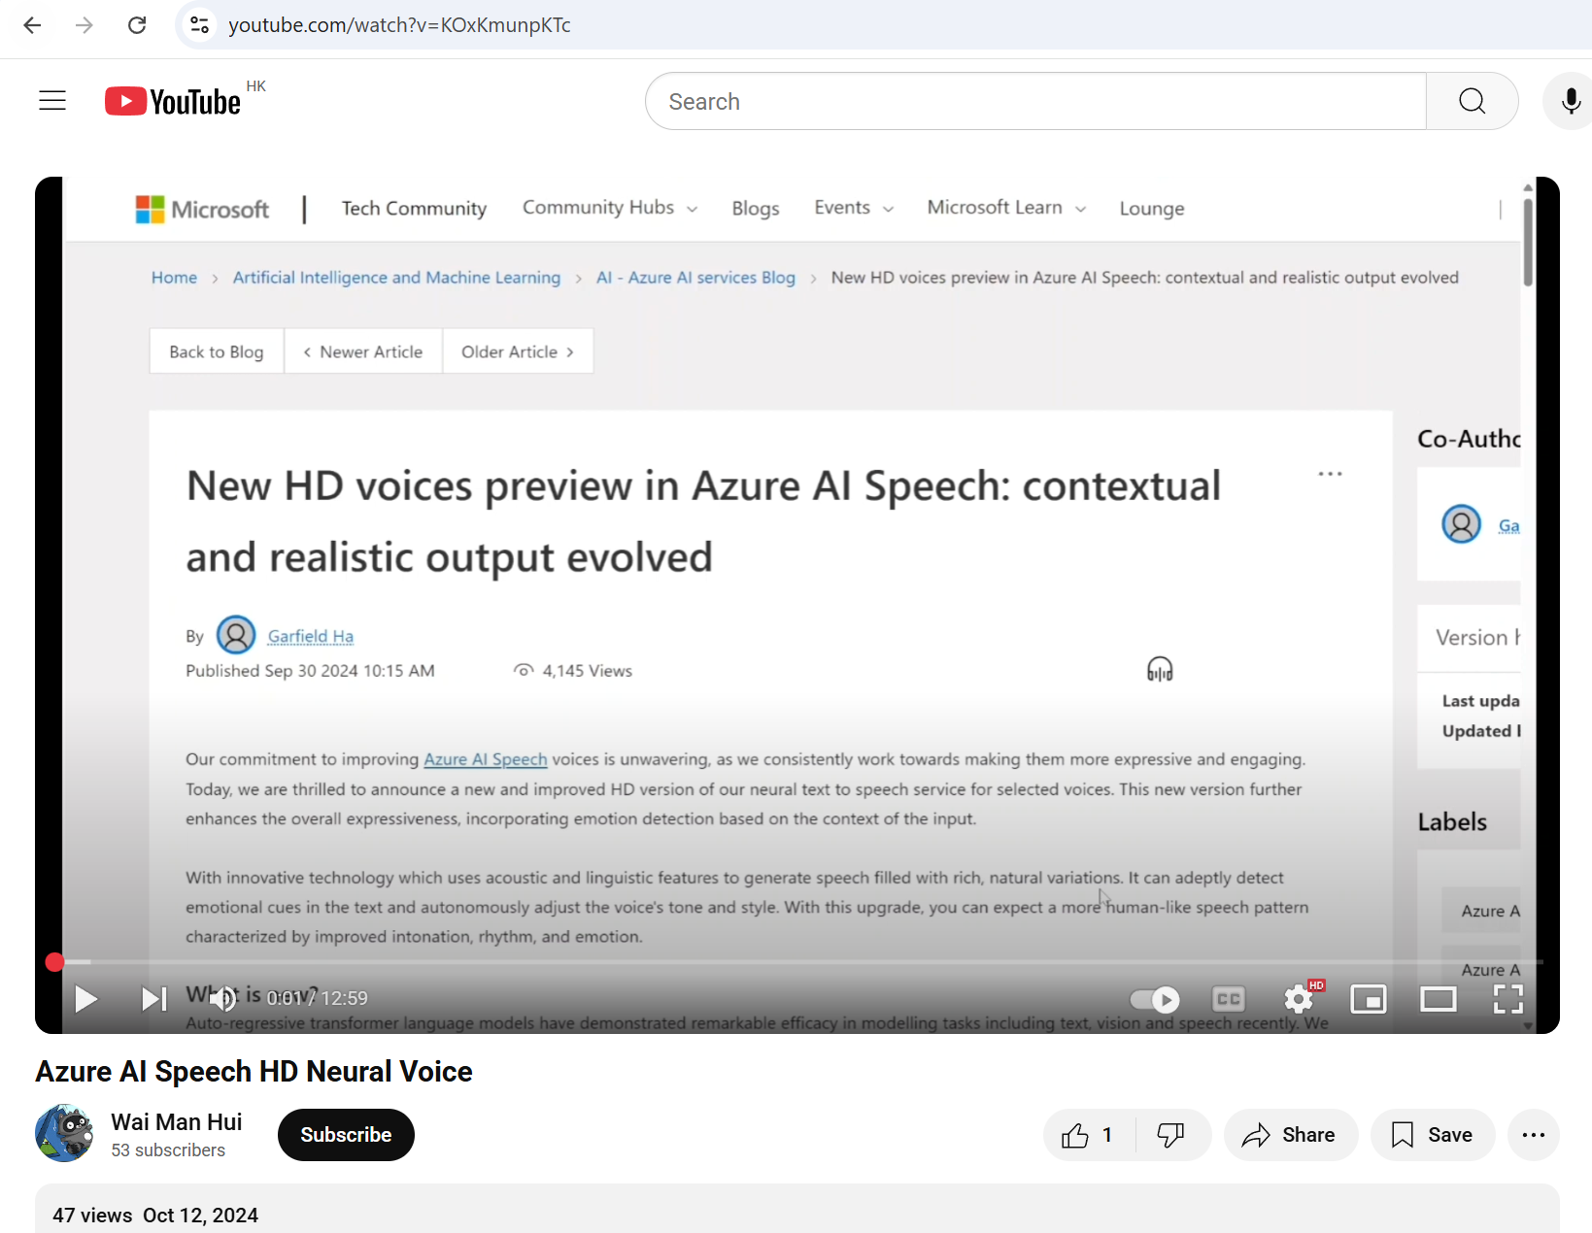

Slide 8
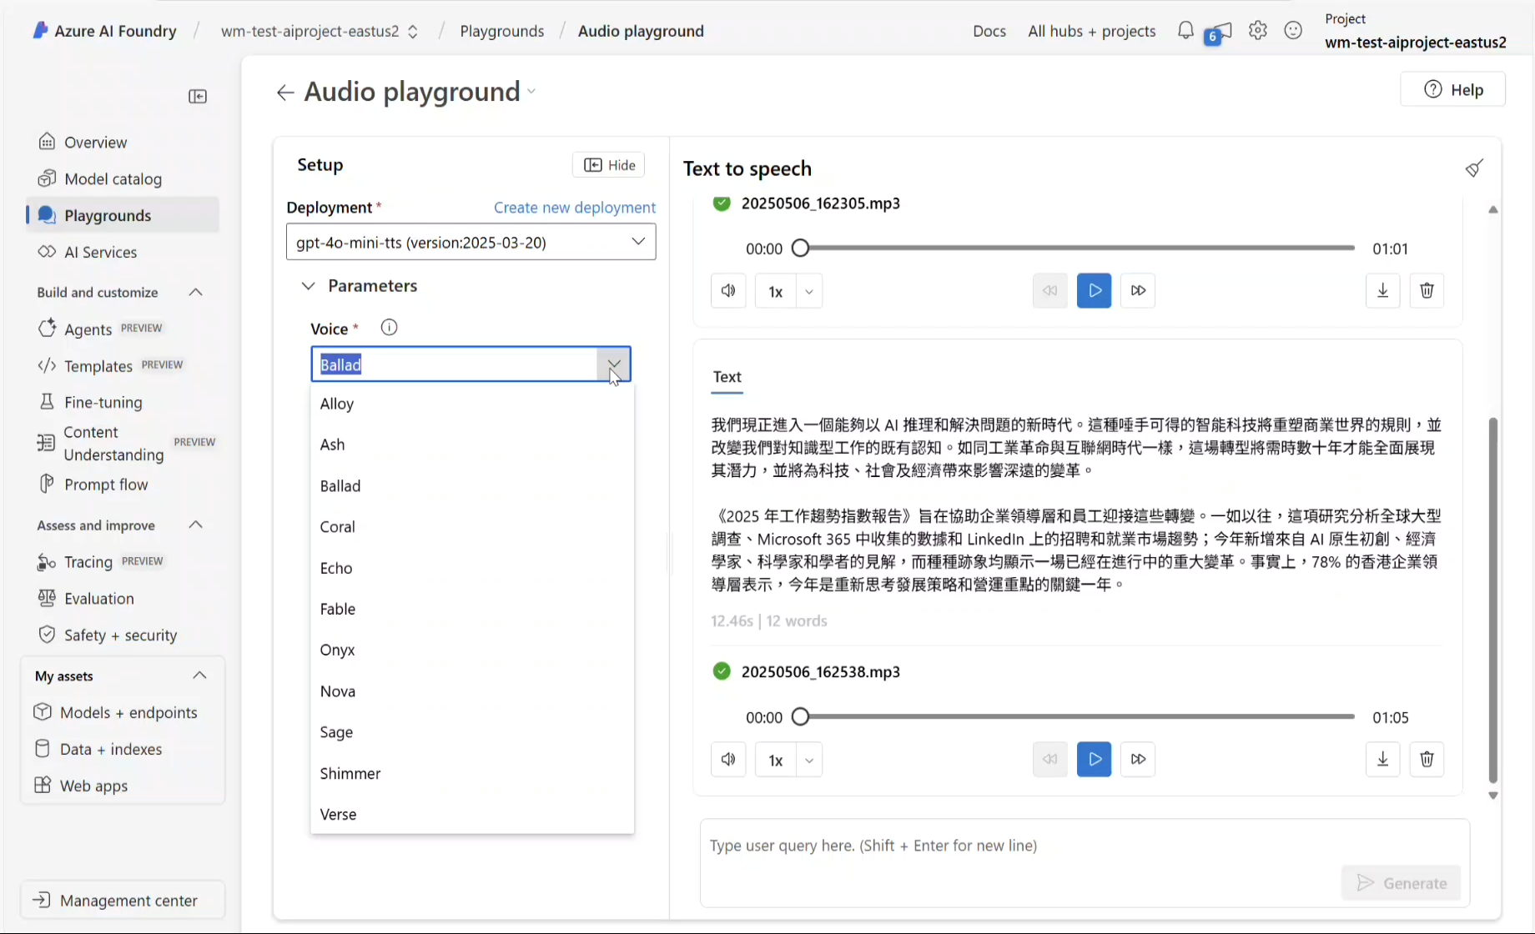

Slide 9
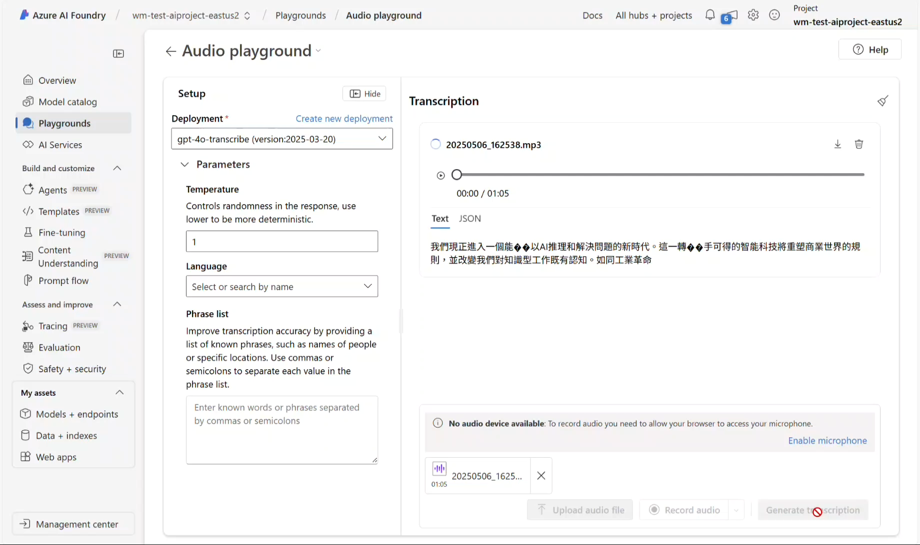

Slide 10
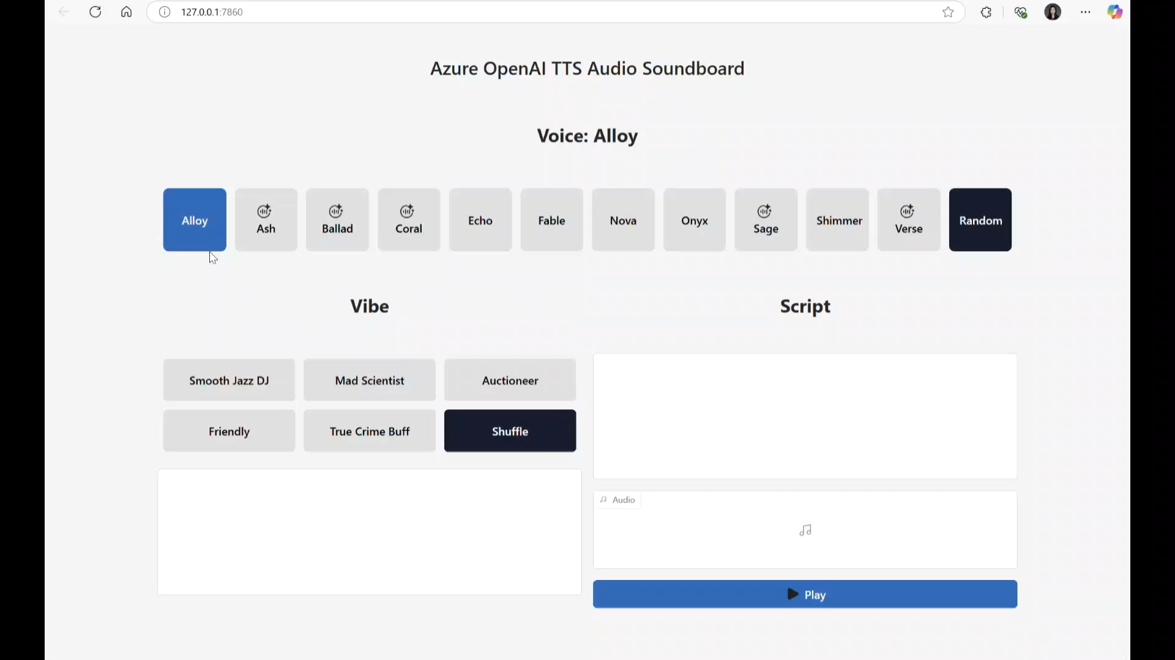
https://github.com/Azure-Samples/azure-openai-tts-demo

Slide 11
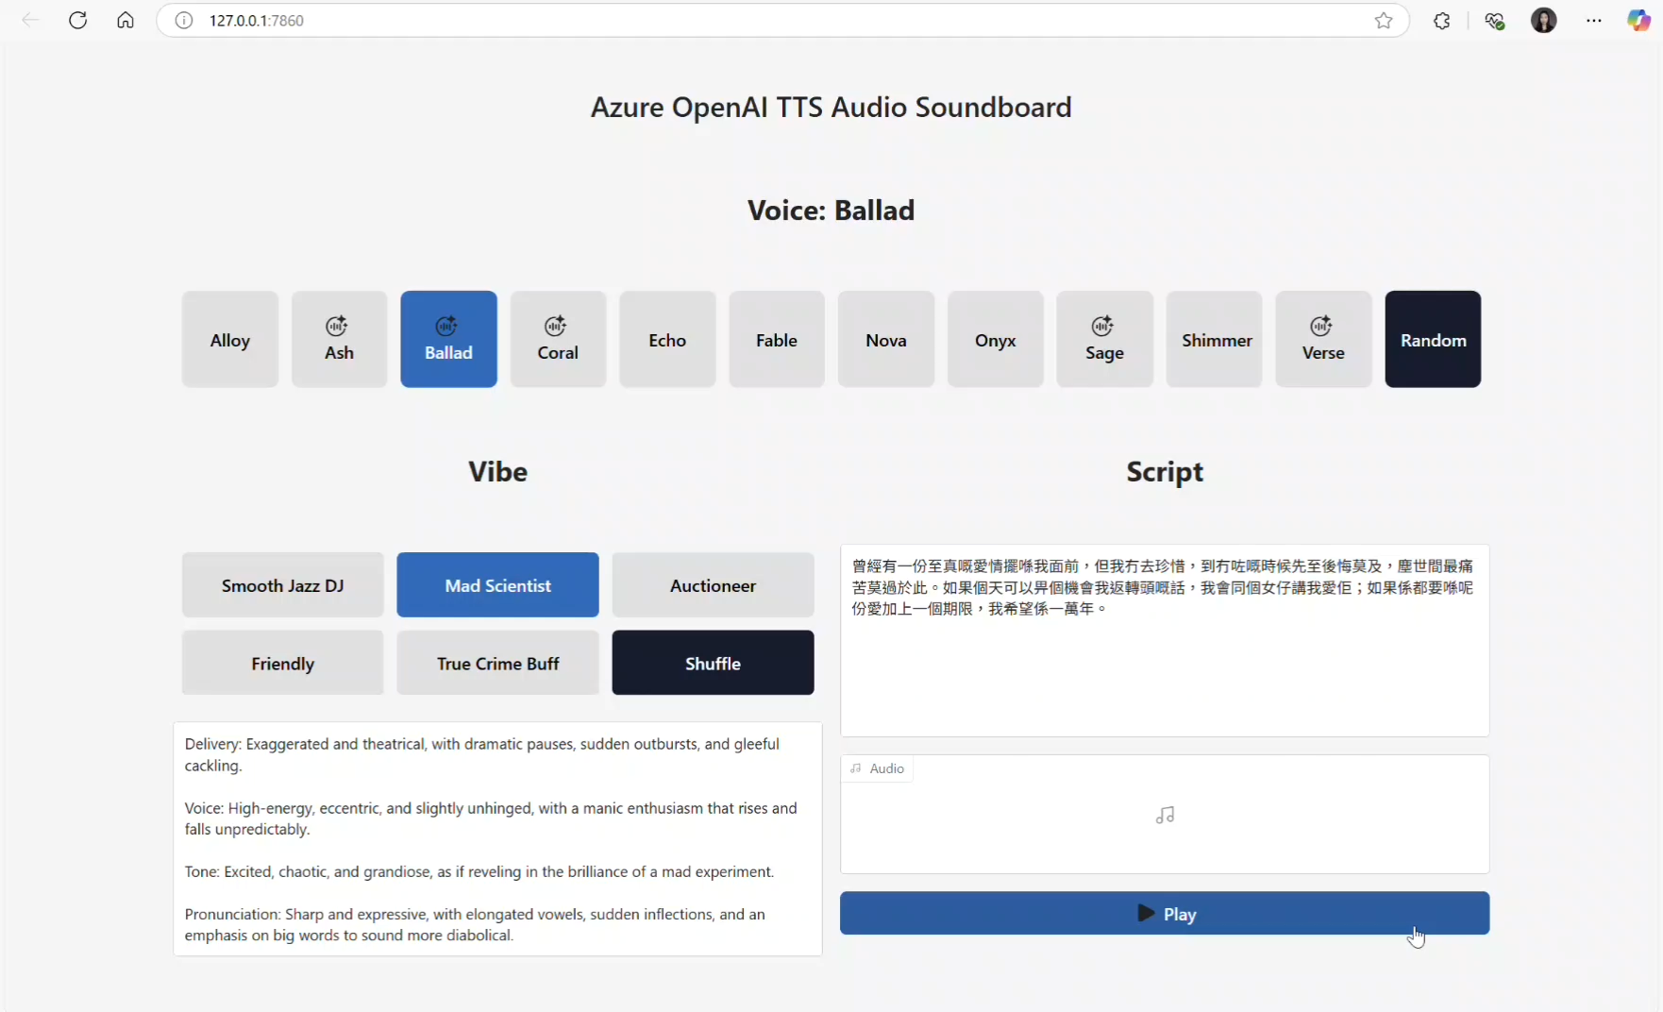

Slide 12
GPT and o* Models
Recent Releases
 | Use Cases | Key Features | Advantages
GPT-4.1 | Customer Service Chatbots Data Analysis Tools Machine Learning Applications | Enhanced Coding Longer context input Improved instruction following | Consistently produces outputs that compile and run successfully Generates cleaner, simpler front-end code Understands extensive context in a single interaction
o3 | Complex problem-solving Multimodal reasoning Enterprise agentic workflows | Advanced STEM capabilities Enhanced coding and logical reasoning Multimodal inputs support Reasoning summaries | Superior reasoning for complex tasks Comprehensive multimodal analysis Robust automation support
o4-mini | Lightweight reasoning tasks Quick analytical insights Streamlined workflow automation | Optimized for smaller workloads Efficient reasoning with lower latency Simplified vision analysis | Cost-effective reasoning Fast and efficient responses Streamlined tool calling

Slide 13
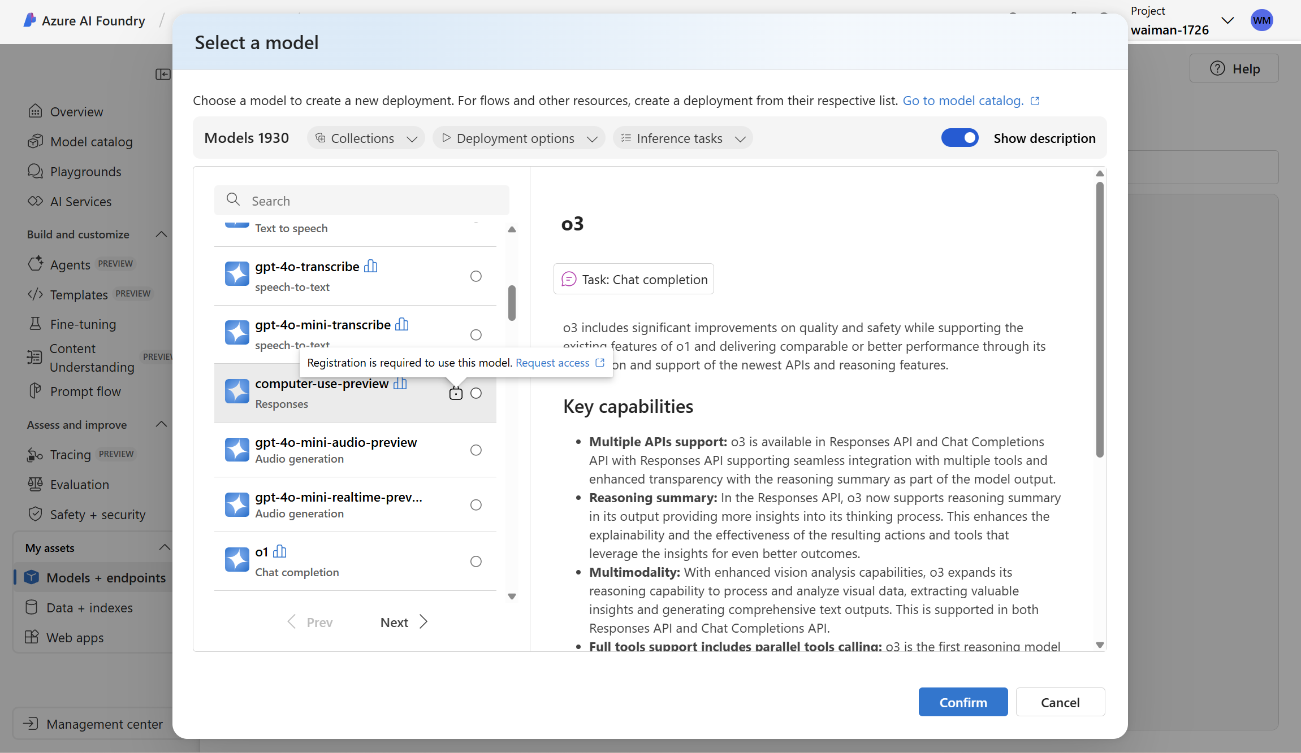

Slide 14
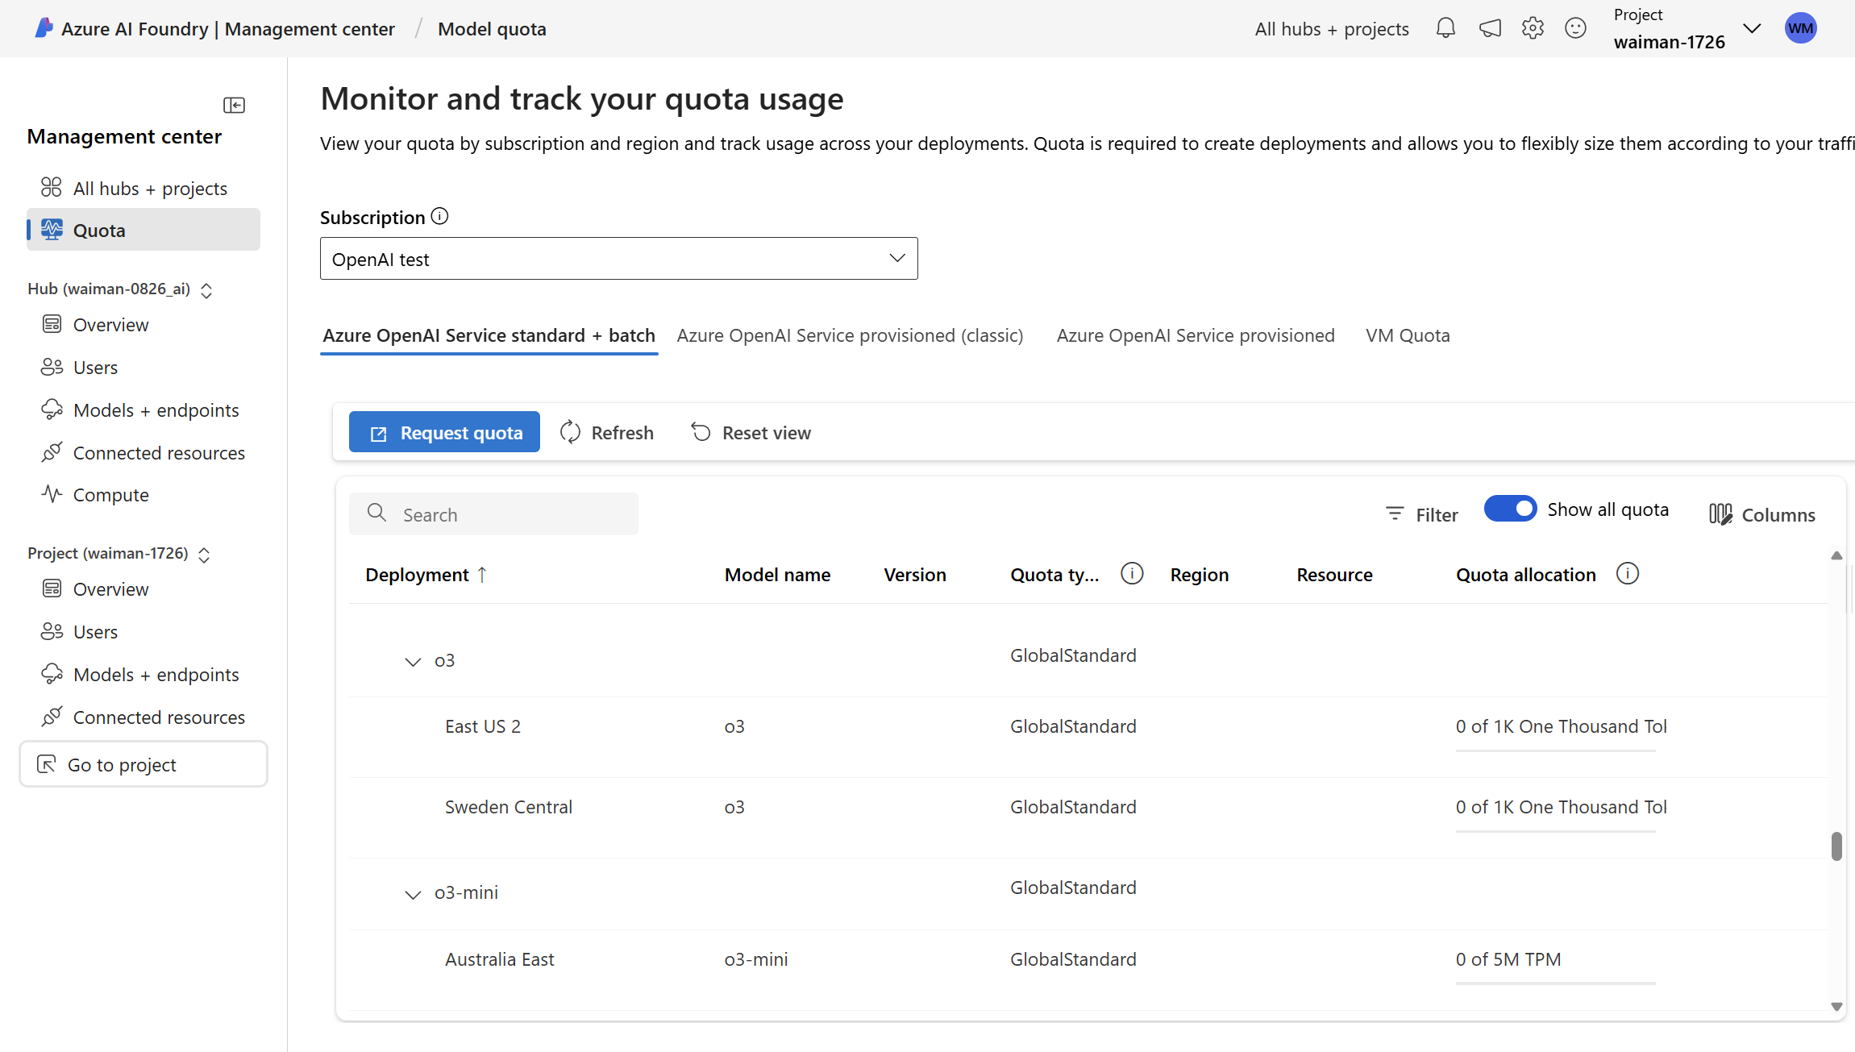

Slide 15
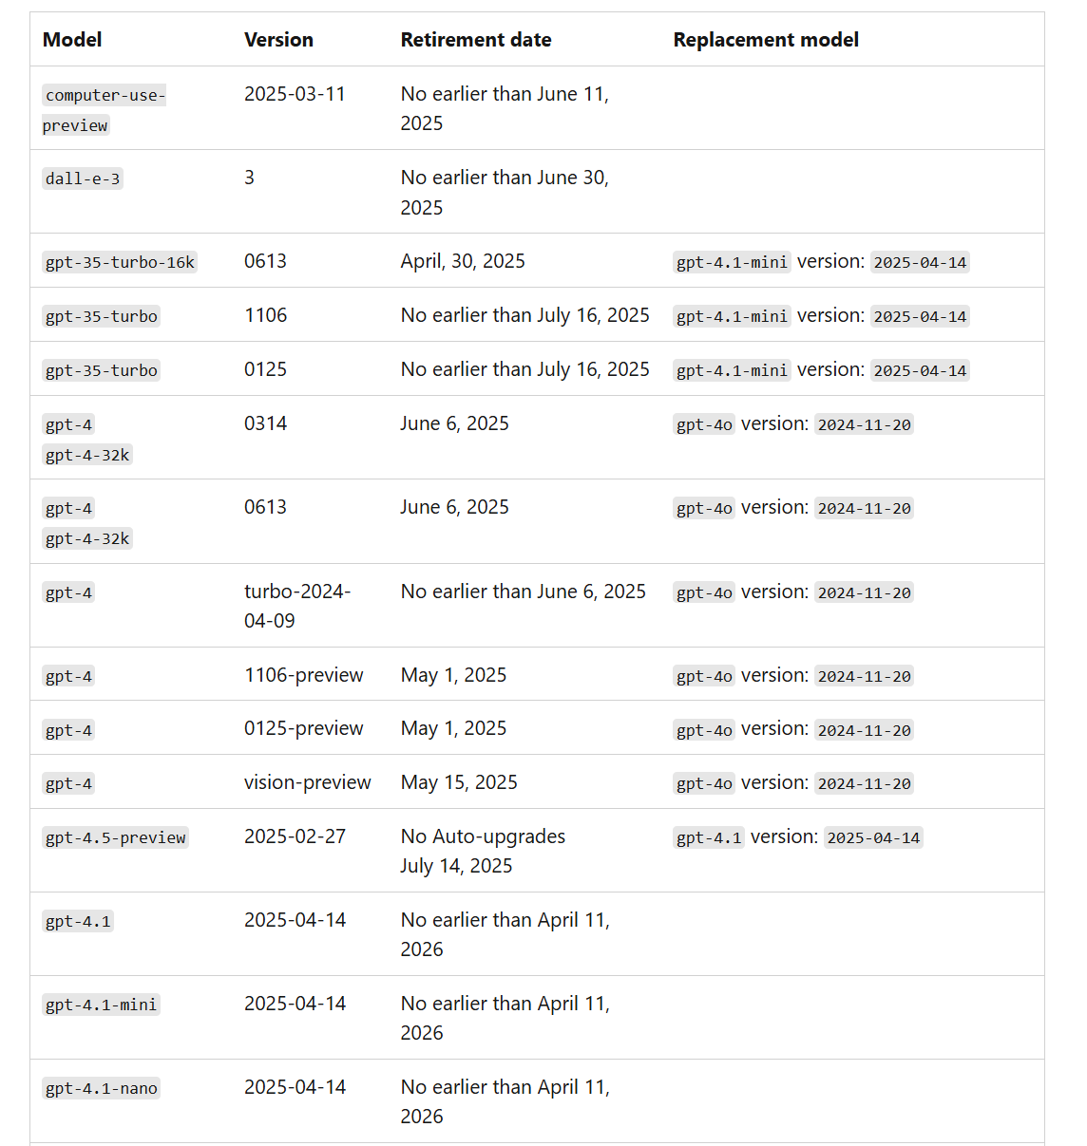
Model Retirement
https://learn.microsoft.com/en-us/azure/ai-services/openai/concepts/model-retirements

Slide 16
GitHub Plan
*all currencies are in USD
For Individual
For Business
Pro
$4/month
Teams
$4/user/month
Enterprise
$21/user/month
Free
Free
Unlimited public/private repos
Unlimited collaborators
2,000 Actions minutes/month
500MB of Packages storage
120 core-hours of Codespaces compute per developer
15GB of Codespaces storage per developer
Community support
Includes everything in GitHub Free plus:
Required reviewers in private repos
Protected branches in private repos
Repository insights in private repos
Wikis in private repos
Pages in private repos
Code owners in private repos
3,000 minutes for GitHub Actions
2GB of GitHub Packages storage
180 core-hours of Codespaces compute
20GB of Codespaces storage
Unlimited public/private repos
Dependabot security and version updates
2,000 CI/CD minutes/month
500MB of Packages storage
Issue & Projects
Community support
Everything includes in Free, plus
Access to GitHub Codespaces
Protected branches
Multiple reviewers in pull requests
Code owners
Pages and Wikis
3,000 CI/CD minutes/month
2 GB of Packages storage
Web-based support
Everything includes in Teams, plus
Data residency
Enterprise Managed Users
User provisioning through SCIM
Audit Log API
SOC1, SOC2, type 2 reports annually
FedRAMP Tailored Authority to Operate (ATO)
SAML single sign-on
50,000 CI/CD minutes/month
50GB of Packages storage
FEATURE ADD-ONS
Premium support
FEATURE ADD-ONS
GitHub Copilot Access
GitHub Codespaces Access
FEATURE ADD-ONS
GitHub Secret Protection
GitHub Code Security
Payment Option
Credit/Debit card
Credit/Debit card
Credit/Debit card
PayPal Account
PayPal Account
PayPal Account
Azure Subscription
https://github.com/settings/billing/plans
https://github.com/features/copilot/plans

Slide 17







GitHub Enterprise Account Type
GHEC
GitHub Enterprise Cloud with personal GitHub accounts
GHEC+EMU
GitHub Enterprise Cloud with Enterprise Managed Users
Control over user account
User in full control over the Account itself
Control over user account lifecycle
Name, Creation, Suspension
Multiple IdPs per Organization
ADFS, AAD, Okta, OneLogin, PingOne, Shibboleth
Single IdP for Enterprise Account AAD, Okta or Ping
No control over user activity
User can interact with GitHub (OSS)
No public presence or OSS participation
Users are read to GitHub, no public repositories

Slide 18

EMU Restrictions
No public repositories for organization or user-owned repositories
No public projects or public GitHub Pages
No outside collaborators. All user accounts must be backed by the identity provider.
No public contributions for EMUs (i.e. performing write actions outside of the Enterprise account)
No gists
No forking from repositories outside of the Enterprise account
GitHub

Slide 19
Azure Metered for GitHub Products
GHE and GHAS will now qualify for Microsoft Azure Consumption Commitment (MACC), Monetary Commit (MC), Azure Credit Offers (ACO) and Azure Committed Revenue (ACR) when Metered billing is selected.
Overview
Important Consideration
Products | ACR MACC | Prepay ACO | ACD SKU Discount
Actions hosted runners | 🟢 | 🟢 | 🟢
Actions large hosted runners | 🟢 | 🟢 | 🟢
GitHub Packages | 🟢 | 🟢 | 🟢
GitHub Storage | 🟢 | 🟢 | 🟢
Codespaces | 🟢 | 🟢 | 🟢
GitHub Copilot （include both Business and Enterprise） | 🟢 | 🟢 | 🟢
GitHub Enterprise Cloud (GHEC) | 🟢 | 🟢 | 🟢
GitHub Advanced Security (GHAS) | 🟢 | 🟢 | 🟢
GHAS for Azure DevOps (GHAzDO) | 🟢 | 🟢 | 🟢
Billing via Azure for GHE/GHAS services
Self-provisioning for customers to convert trial to paid
Licensing Type Transition Support to help customer make the update
Enhanced Billing Experience with enhanced capabilities
GHAS Enablement & Trial Experience synced between GHE and GHAS

Slide 20
GitHub Advanced Security Capabilities
Code Scanning
Secret Scanning
Supply Chain Security
Static analysis of every pull request, integrated into the developer workflow and powered by CodeQL
Automatic notifications of any API tokens or other secrets exposed anywhere in your git history
Secure the open source dependencies your applications rely on

Slide 21
GitHub Plan
*all currencies are in USD
For Individual
For Business
Pro
$4/month
Teams
$4/user/month
Enterprise
$21/user/month
Free
Free
Unlimited public/private repos
Unlimited collaborators
2,000 Actions minutes/month
500MB of Packages storage
120 core-hours of Codespaces compute per developer
15GB of Codespaces storage per developer
Community support
Includes everything in GitHub Free plus:
Required reviewers in private repos
Protected branches in private repos
Repository insights in private repos
Wikis in private repos
Pages in private repos
Code owners in private repos
3,000 minutes for GitHub Actions
2GB of GitHub Packages storage
180 core-hours of Codespaces compute
20GB of Codespaces storage
Unlimited public/private repos
Dependabot security and version updates
2,000 CI/CD minutes/month
500MB of Packages storage
Issue & Projects
Community support
Everything includes in Free, plus
Access to GitHub Codespaces
Protected branches
Multiple reviewers in pull requests
Code owners
Pages and Wikis
3,000 CI/CD minutes/month
2 GB of Packages storage
Web-based support
Everything includes in Teams, plus
Data residency
Enterprise Managed Users
User provisioning through SCIM
Audit Log API
SOC1, SOC2, type 2 reports annually
FedRAMP Tailored Authority to Operate (ATO)
SAML single sign-on
50,000 CI/CD minutes/month
50GB of Packages storage
FEATURE ADD-ONS
Premium support
FEATURE ADD-ONS
GitHub Copilot Access
GitHub Codespaces Access
FEATURE ADD-ONS
GitHub Secret Protection
GitHub Code Security
Payment Option
Credit/Debit card
Credit/Debit card
Credit/Debit card
PayPal Account
PayPal Account
PayPal Account
Azure Subscription
https://github.com/settings/billing/plans
https://github.com/features/copilot/plans

Slide 22
GHAS Bundle
GitHub Advanced Security Products
GHCS
Code Security
GHAS
GitHub Advacned Security
Code Scanning
Code Scanning
Dependency Review
CodeQL
$30/committer/month
Security Campaigns
Secret Scanning
Copilot Autofix
Dependency Review
Copilot Autofix
GHSP
Secret Protection
Available as Subscription or Metered
Secret Scanning
$19/committer/month
$49/committer/month
Starting April 1st, GHAS will be available as Code Security and Secret Protection

Slide 23
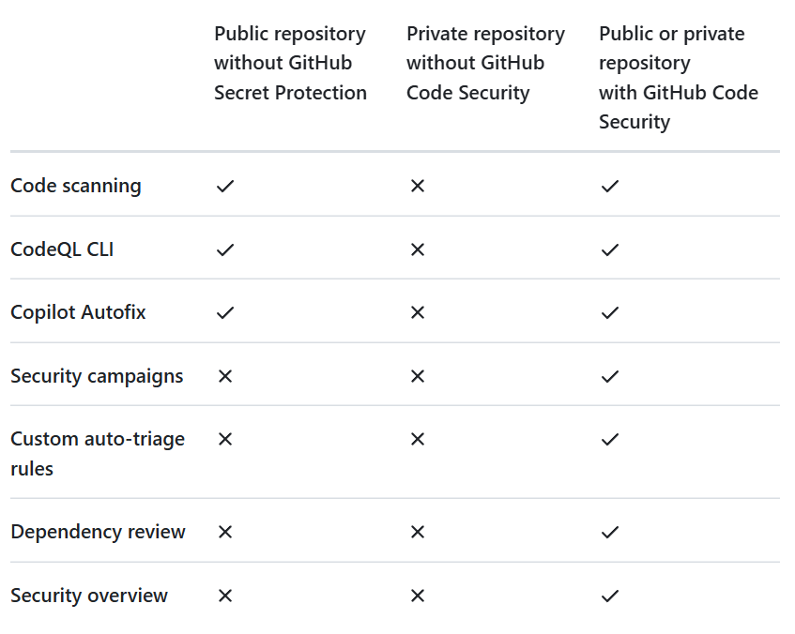
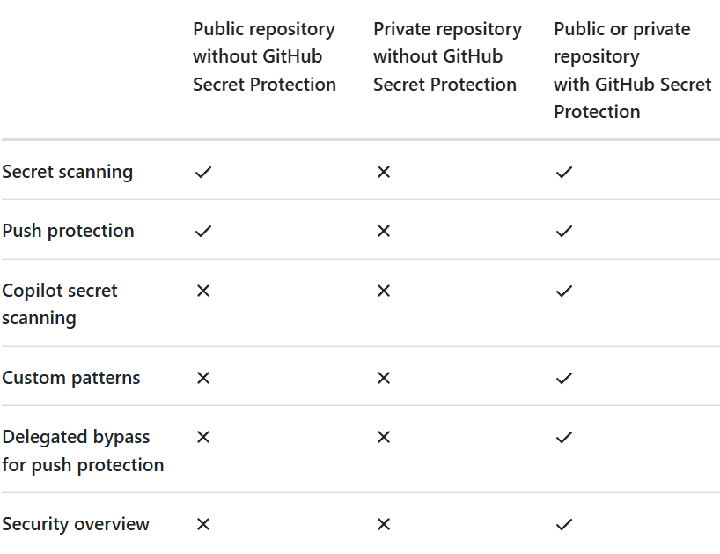
GitHub Advanced Security
GHCS
Code Security
GHSP
Secret Protection

Slide 24
GitHub Advanced Security
GitHub Advanced Security Products
Instance Type | GHSP Metered | GHCS Metered | GHSP Subscription | GHCS Subscription | Metered Bundled GHAS | Subscription Bundled GHAS
GHE - Cloud | ✅ | ✅ | ✅ | ✅ | ⚠️ | ✅
GHE - Server | ✅ (v3.17+) | ✅ (v3.17+) | ✅ | ✅ | ⚠️ | ✅
GitHub Team | ✅ | ✅ | ❌ | ❌ | ❌ | ❌
✅ Available and preferred path
⚠️ Only available for existing GHAS customers
❌ Not available

Slide 25
GitHub Copilot Plan
*all currencies are in USD
For Individual
For Business
Pro
$4/month
Teams
$4/user/month
Enterprise
$21/user/month
Free
Free
Pro
$10/month
or $100 per year
Pro+
$4/month
or $100 per year
Business
$19/user/month
Enterprise
$39/user/month
Copilot
Free
50 agent mode or chat requests per month
2,000 completions per month
Access to Claude 3.5 Sonnet, GPT-4o, and more
Everything in Free and:
Unlimited agent mode and chats with GPT-4o
Unlimited code completions
Access to code review, Claude 3.7 Sonnet, o1, and more
6x more premium requests to use latest models than Free, with the option to buy more
Everything in Pro and:
Access to all models, including GPT-4.5
30x more premium requests to use latest models than Free, with the option to buy more
Unlimited agent mode and chats with GPT-4o
Unlimited code completions
Access to code review, Claude 3.5/3.7 Sonnet, o1, and more
300 premium requests to use latest models per user, with the option to buy more
User management and usage metrics
IP indemnity and data privacy
Everything in Business and:
Access to all models, including GPT-4.5
3.33x more premium requests to use latest models than Business, with the option to buy more
30 days trial included in GitHub Enterprise trial
30 days trial available
Payment Option
Credit/Debit card
Credit/Debit card
PayPal Account
PayPal Account
Azure Subscription
https://github.com/features/copilot/plans

Slide 26
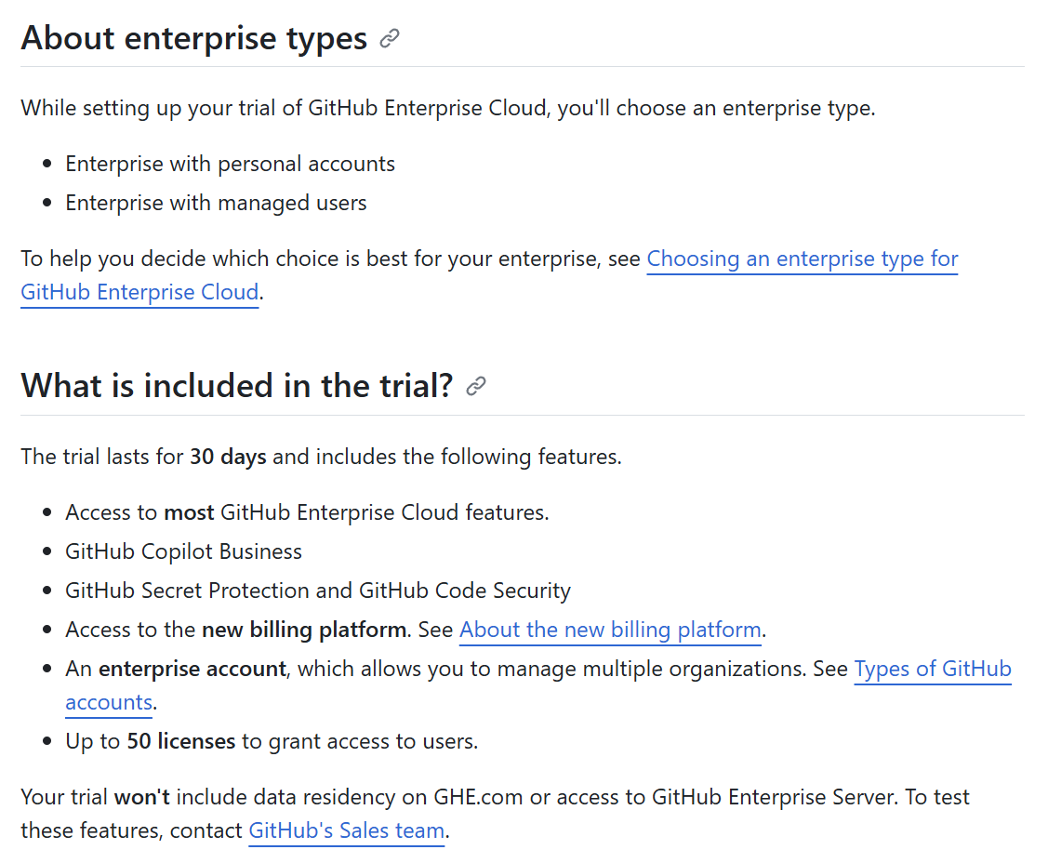
GitHub Enterprise Trial Started with 30 days, includes GHEC, GHAS and Copilot for Business
https://docs.github.com/en/enterprise-cloud@latest/admin/overview/setting-up-a-trial-of-github-enterprise-cloud

Slide 27
Introduce MCP@Microsoft

Slide 28








MCP is
an open protocol that enables seamless integration between LLM applications and your tools & data sources.
💻 Client
🤖 Server
🔨Tooling
👨‍💻SDKs
Data and file systems
Development tools
Web and browser automation
Productivity and communication
AI and specialized tools
Inspector
Claude Desktop DevTools

Slide 29



MCP Server@Microsoft
Azure MCP
https://github.com/azure/azure-mcp
PlayWright MCP
https://github.com/microsoft/playwright-mcp
File MCP
https://github.com/microsoft/files-mcp-server

Slide 30
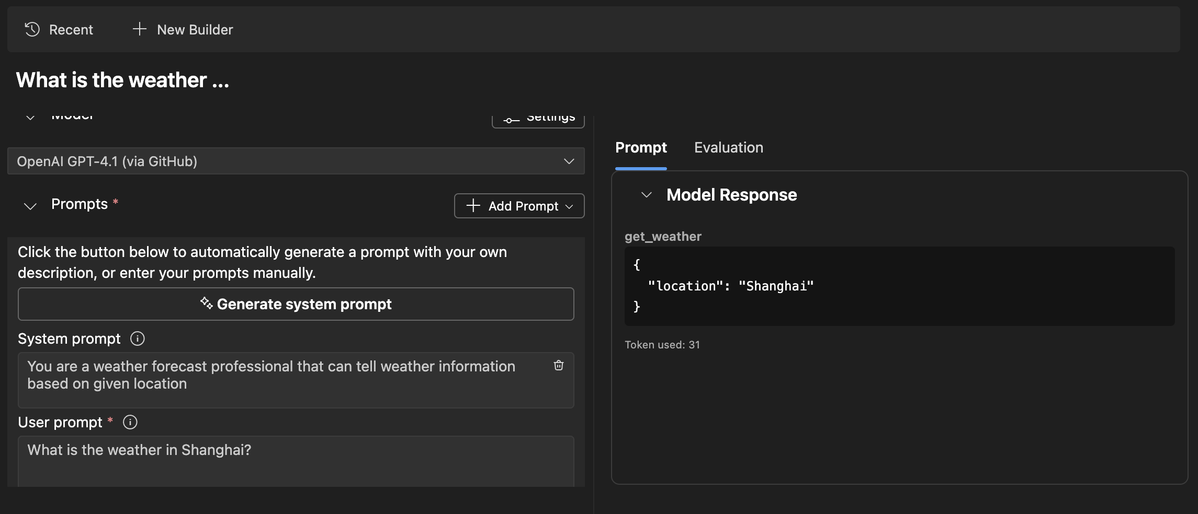

How to dev a MCP Server
AITK
Agent Builder

Slide 31
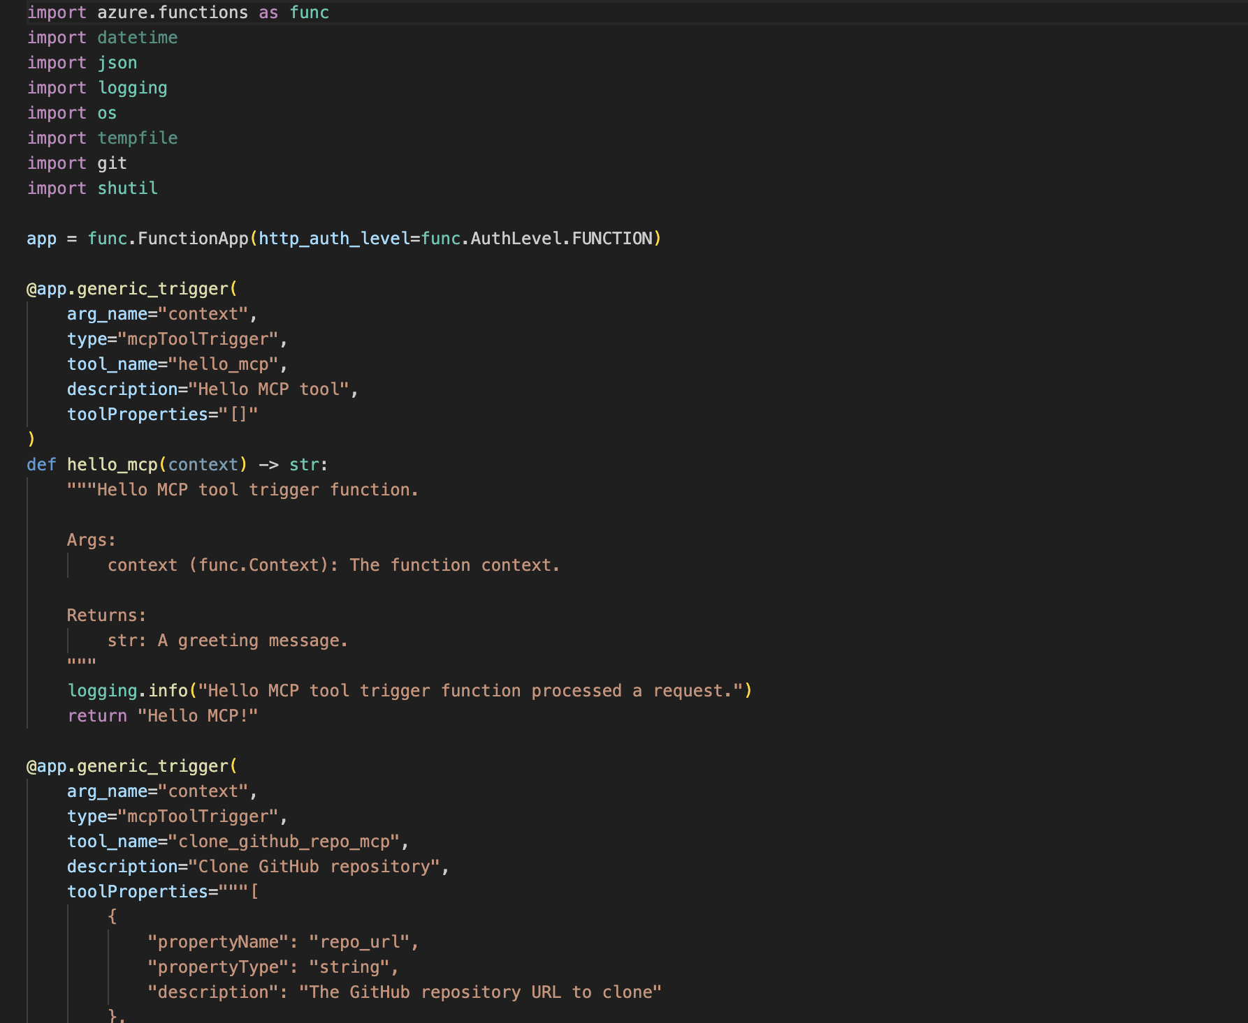

Azure Function@MCP

Slide 32


Phi-4-mini MCP Client in Edge AI
STDIO
🛠️
Local Tool List
Phi-4-mini-3.8B
MCP
MCP Server
MCP Client
Edge Devices
🛠️
Remote Tool List
SSE

Slide 33







Ken Lin
Working with Copilot Agent Mode
MCT Regional Lead
MCT Community Lead
Microsoft MVP (2003 – 2017)
Microsoft Community Star (HK & TW) Microsoft Learn Expert Microsoft Learning Room Organizer – Azure Cantonese Hub
Global AI Community Hong Kong Chapter Owner
/in/mvpkenlin

Slide 34
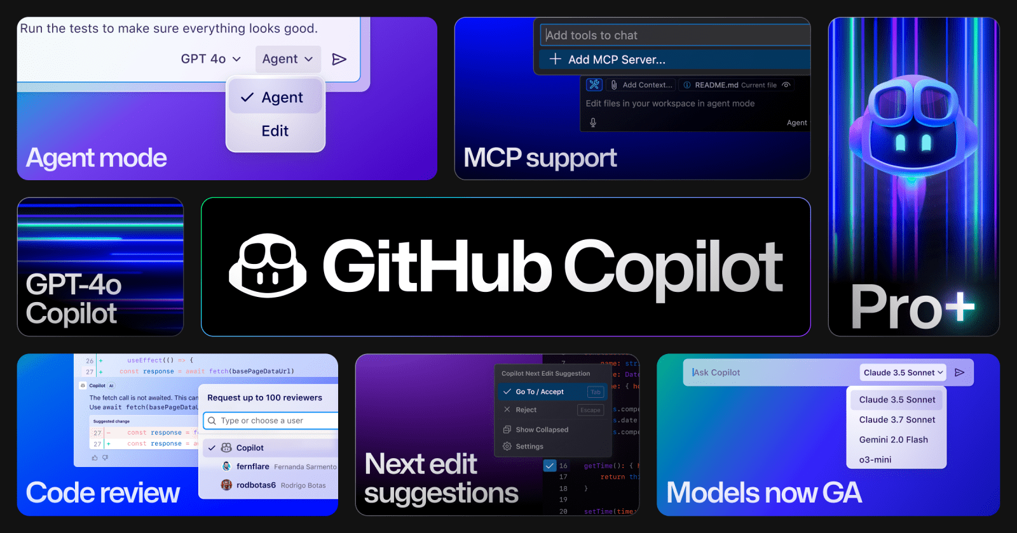

Slide 35
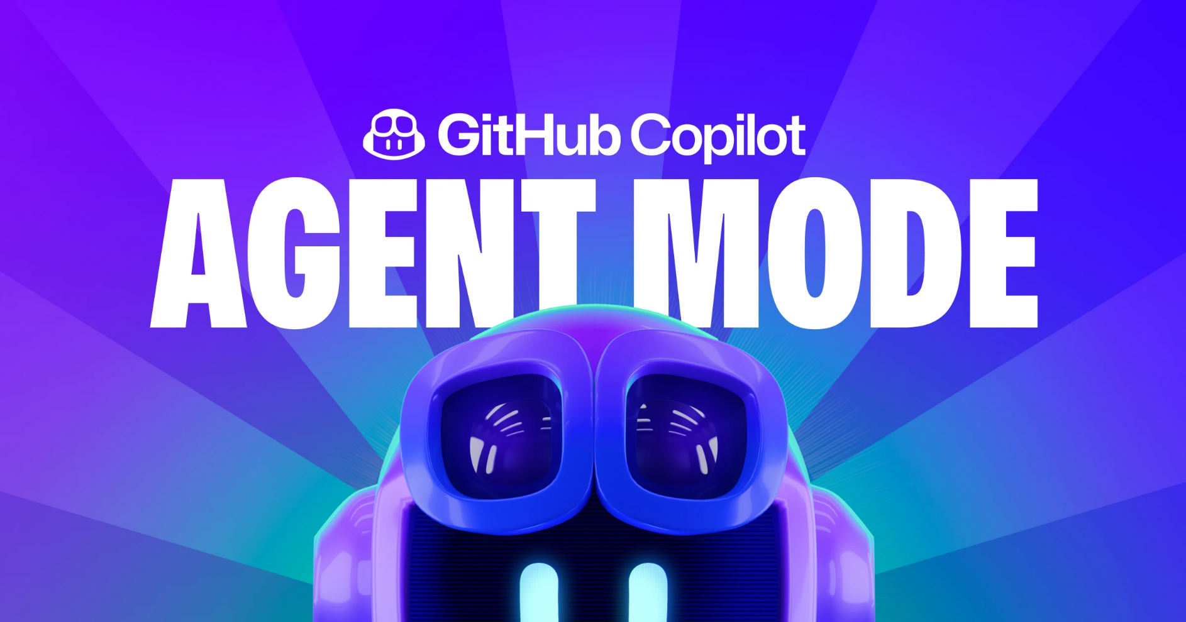

Slide 36

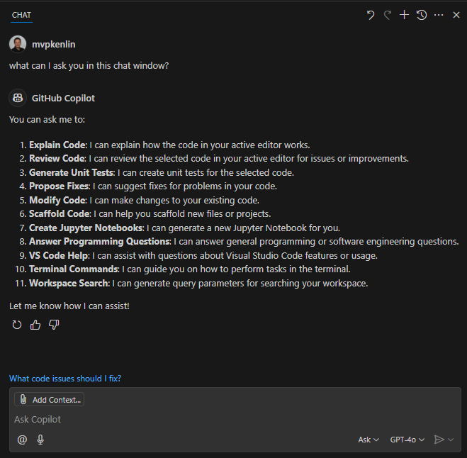

GitHub Copilot
GitHub Copilot Chat
Ask in GitHub Copilot Chat to get started
Ask coding questions like “How do I implement JWT authentication in Node.js?”

Slide 37
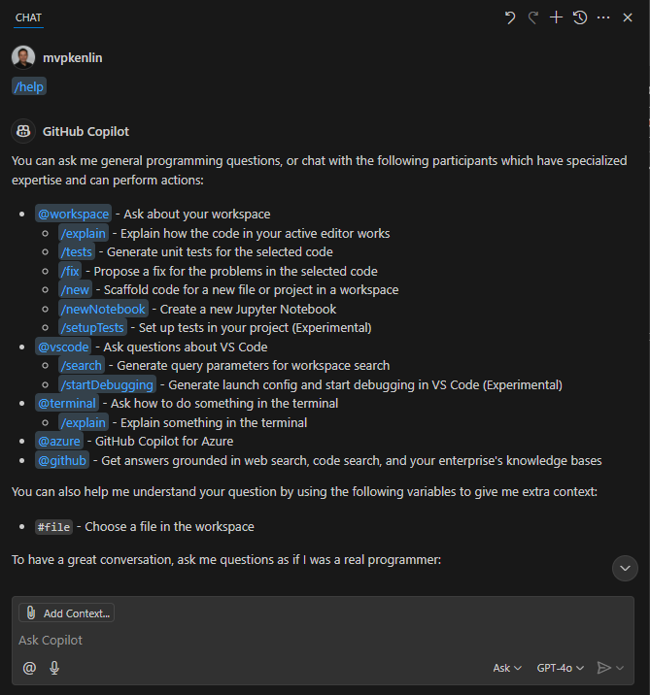
GitHub Copilot
Working with Commands
Use the / command in GitHub Copilot Chat to start a task
Use /explain to understand complex code blocks
Debug issues with /fix
Generate tests with /tests
Ask questions about open project with @workspace

Slide 38
GitHub Copilot
GitHub Copilot Agent Mode
Generally Available (GA)
Next evolution of AI-assisted development
An autonomous peer programmer
Analyzes your codebase to gather full context
Agent Mode iterates on its own code
Integrate GitHub functionality into any LLM tool (via MCP)

Slide 39
GitHub Copilot
Exploring the power of Agent Mode
Autonomous operation
Multi-step tasks
Tools for task completion
Code changes and terminal commands
Iteration and self-healing
User control and review
Context management
Undo and Redo
Interrupting requests
Limitations

Slide 40
GitHub Copilot
What makes Agent Mode special
Codebase Search
Self-Iteration
Error Identification and Repair
Terminal Command Execution
Build and Run Capabilities

Slide 41

Demo

Slide 42

GitHub Copilot
Learning Objective
Understand how to develop with VS Code IDE in a GitHub Codespace
Prompt GitHub Copilot Agent Mode to create an application
Leverage documentation files to instruct GitHub Copilot agent mode
GitHub Copilot Agent Mode iterates over a code base to:
Fix errors
Refactor code
Develop new features
https://github.com/continuous-copilot/ build-applications-w-copilot-agent-mode

Slide 43
GitHub Copilot
Chat vs Edit vs Agent Mode
Feature/Aspect | Chat | Edit | Agent Mode
Primary Functionality | Provides conversational AI assistance for coding, debugging, and learning. | Suggests and edits code inline based on context and user prompts. | Automates complex workflows and tasks, acting as an intelligent assistant for development.
Interaction Style | Chat-based interface for asking questions, debugging, and generating code snippets. | Inline code suggestions and edits directly in the editor. | Task-oriented commands executed via prompts or workflows.
Use Case | Ideal for learning, debugging, and exploring coding concepts interactively. | Best for quick code fixes, refactoring, and generating boilerplate code. | Designed for automating repetitive tasks, managing projects, and accelerating development.
Supported Models | Supports multiple LLMs (e.g., GPT-4o, Claude Sonnet) with conversational capabilities. | Uses context-aware AI models for inline suggestions. | Leverages advanced models for task automation and multi-step workflows.
Customization | Allows prompt engineering and fine-tuning for specific tasks. | Limited to inline suggestions based on the current file and context. | Highly customizable for automating workflows and integrating with external tools.
Integration | Works within the IDE as a chat panel. | Integrated directly into the code editor for inline suggestions. | Extends IDE functionality with advanced automation and multi-tool integration.
Examples of Usage | Debugging code, asking for explanations, generating documentation. | Refactoring code, generating functions, fixing syntax errors. | Setting up project scaffolding, automating CI/CD pipelines, managing dependencies.
Learning Curve | Easy to use with natural language queries. | Minimal learning curve; works seamlessly with existing workflows. | Requires understanding of task automation and prompt engineering.
Best For | Developers seeking interactive assistance and explanations. | Developers needing quick inline suggestions and edits. | Teams and developers looking to automate complex workflows and repetitive tasks.

Slide 44
GitHub Copilot
Reach for… when...
“
“
Your go-to for fast, precise tweaks
Refactoring a function
Squashing a bug
Applying consistent changes across files without losing your flow
Building complete features
Navigating unfamiliar codebases
Writing and verifying tests
Implementing terminal-heavy tasks
Doing complex refactoring
Reach for GitHub Copilot Edit when...
Reach for GitHub Copilot Agent Mode when...

Slide 45
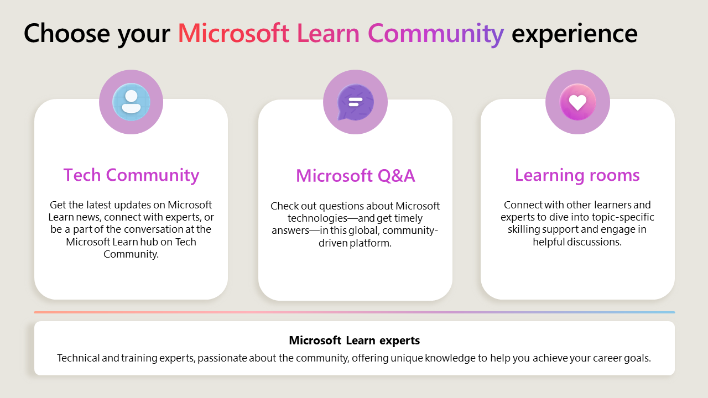

Slide 46
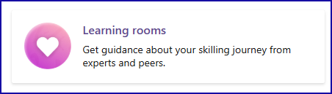
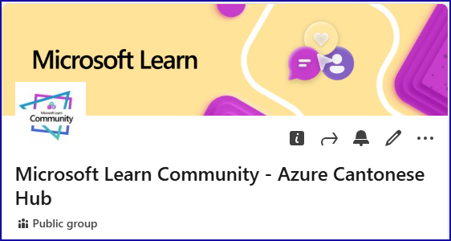

Join us - Learning Community in Cantonese!
https://learn.microsoft.com/en-us/training/learn-community
Check "Azure Cantonese Hub" Learning Room
https://www.linkedin.com/groups/14628185/
https://globalai.community/chapters/hong-kong/

Slide 47




https://register.build.microsoft.com/

Slide 48
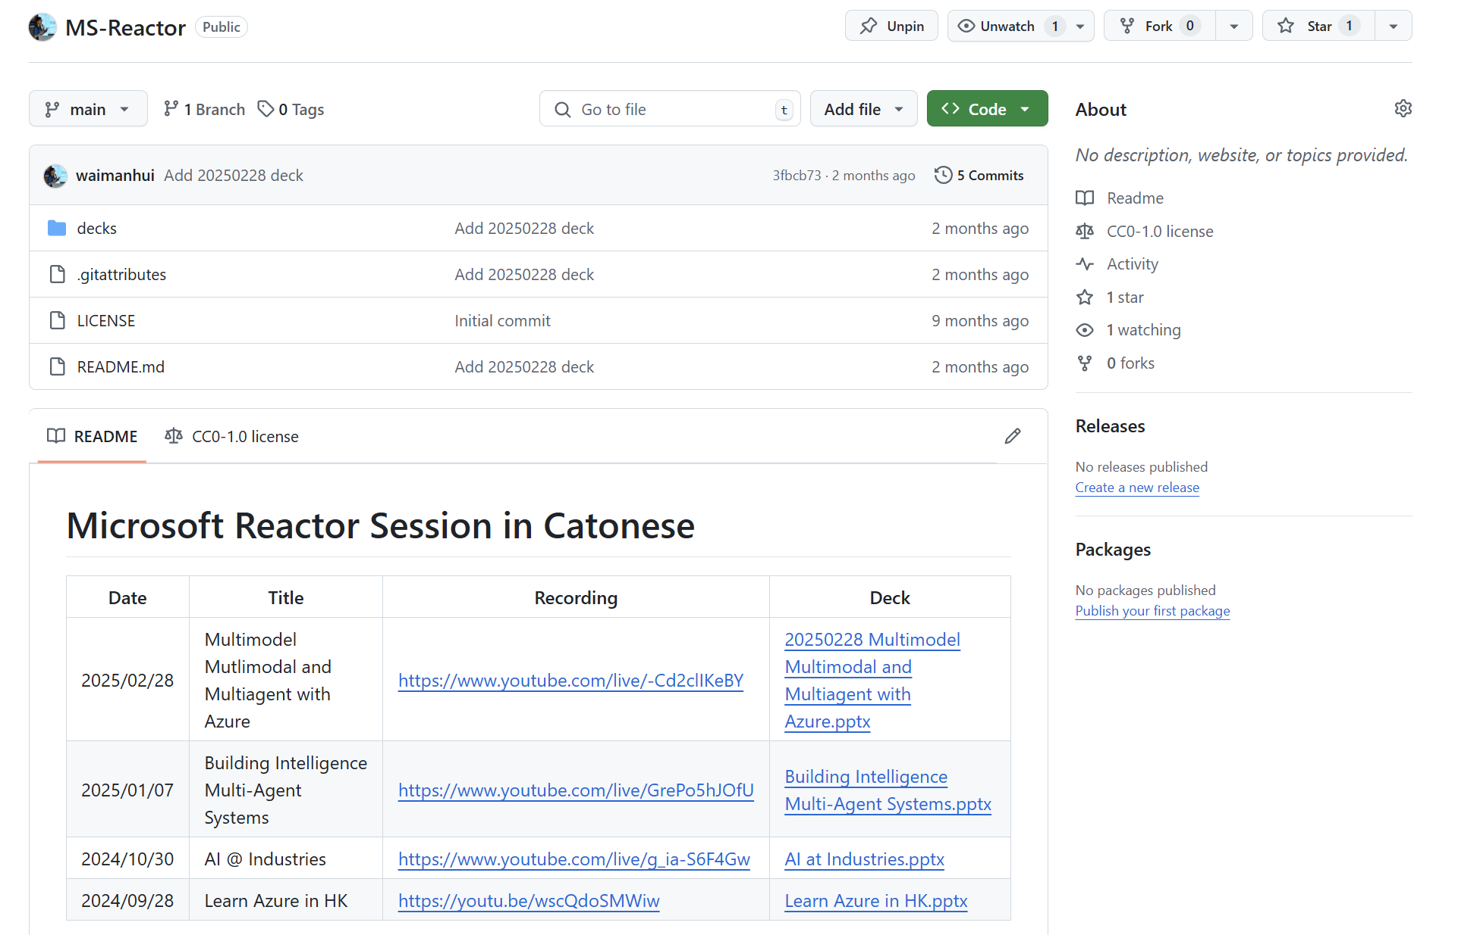
https://github.com/waimanhui/MS-Reactor

Slide 49
Thank you

